Slide 1
Button maker
Pictures or Spirit Wear! Lots of ideas!

Slide 2
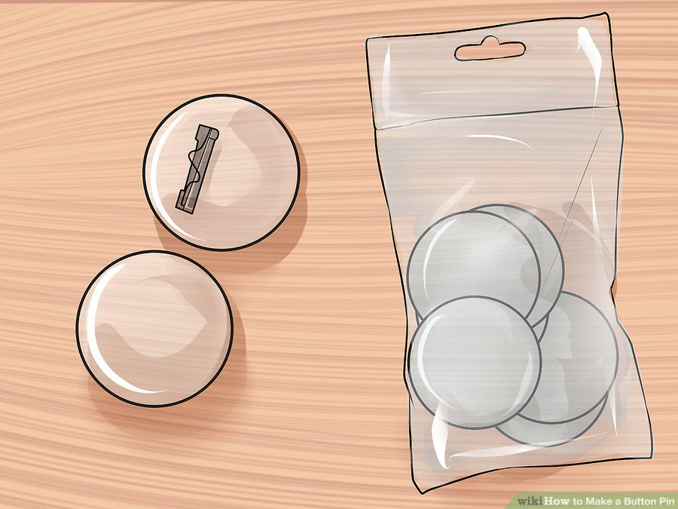
Step one: identify and gather materials needed to complete order

Slide 3
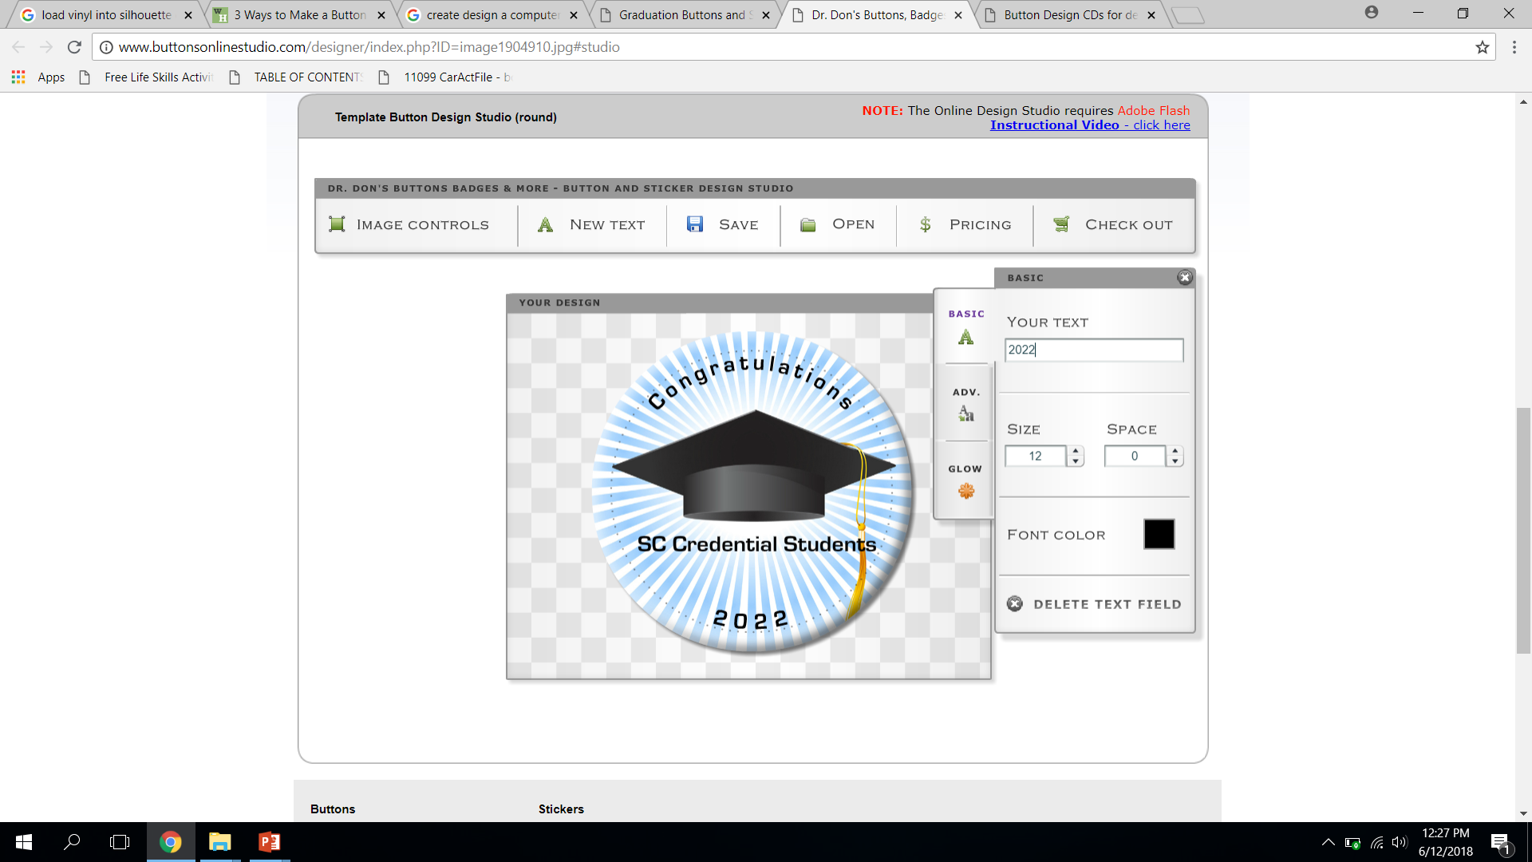
Step two: create design on computer in button maker software

Slide 4
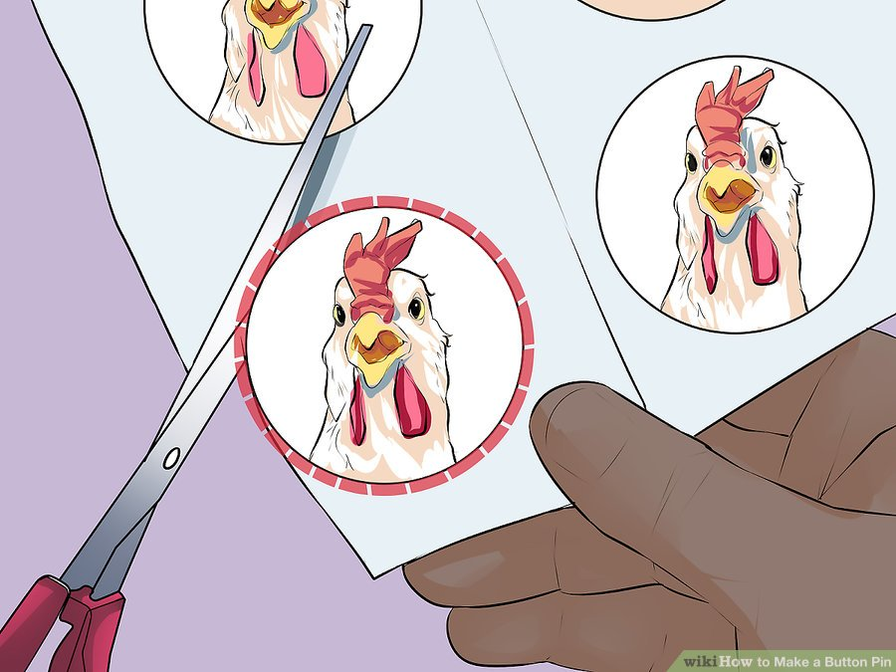
Step three: Print and cut buttons

Slide 5
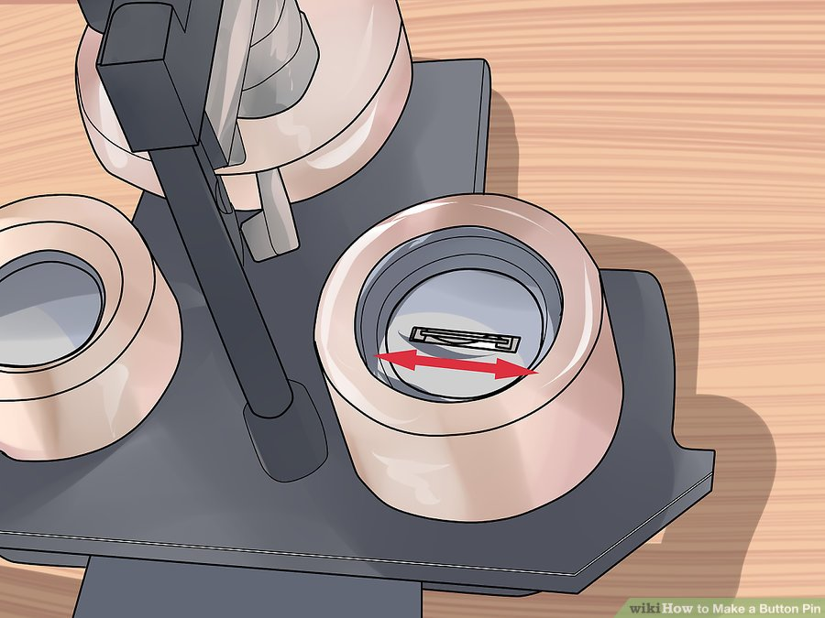
Step four: place back metal part of button in machine (Clip down)

Slide 6
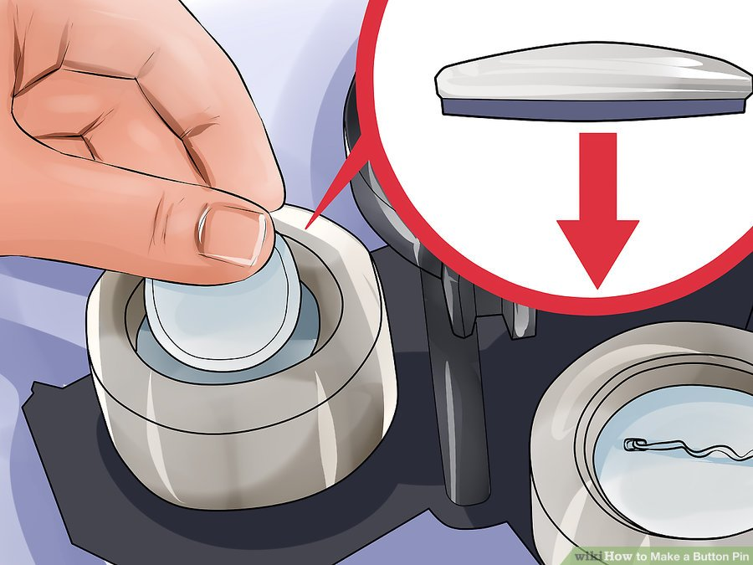
Step five: place front metal part –face up

Slide 7
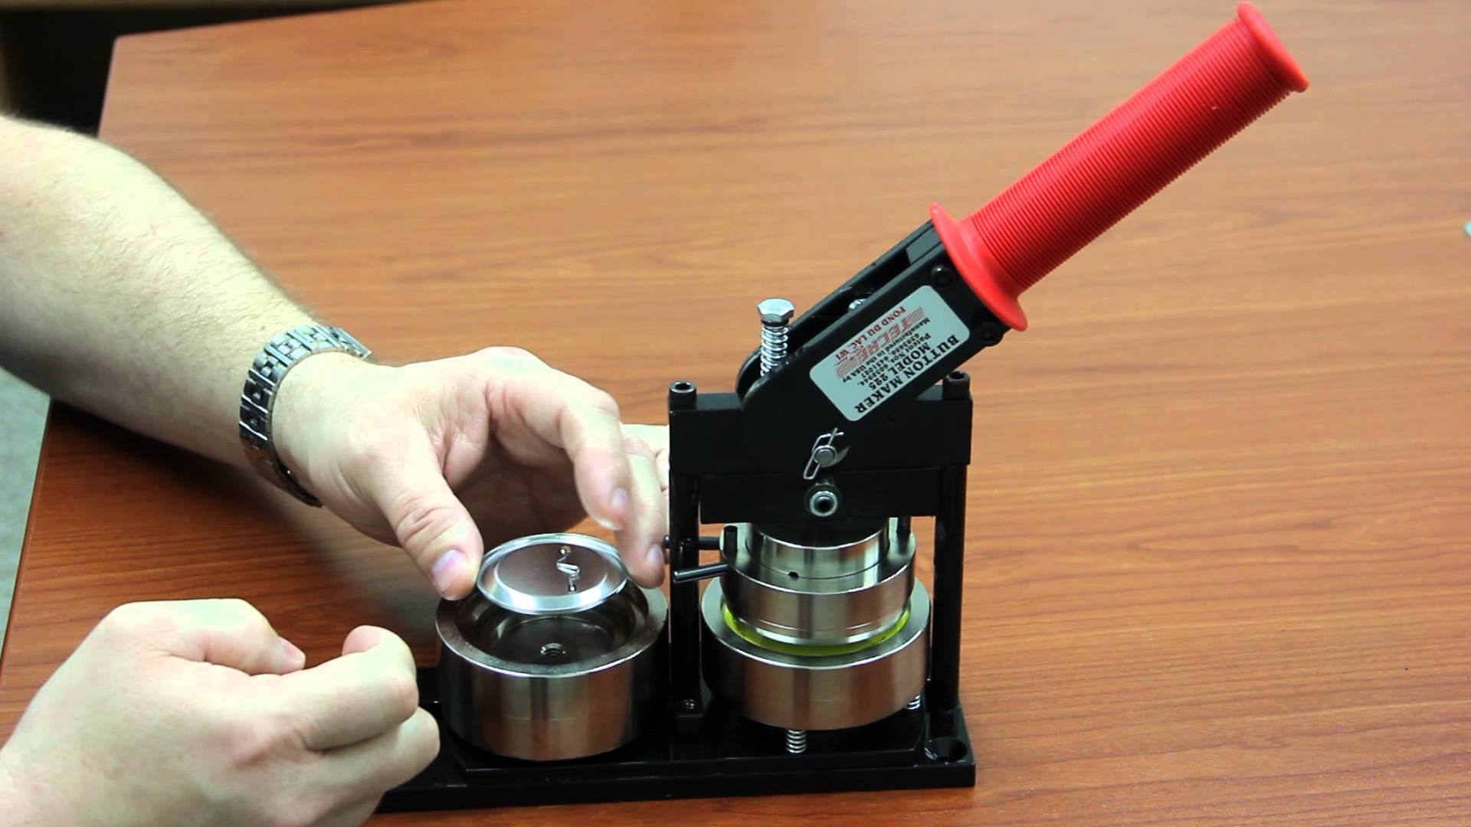
Step six: position both parts in machine

Slide 8
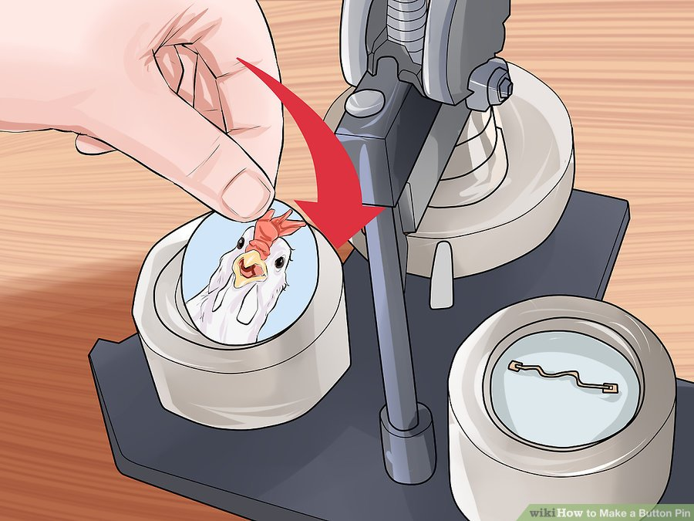
Step seven: place picture on top of front button

Slide 9
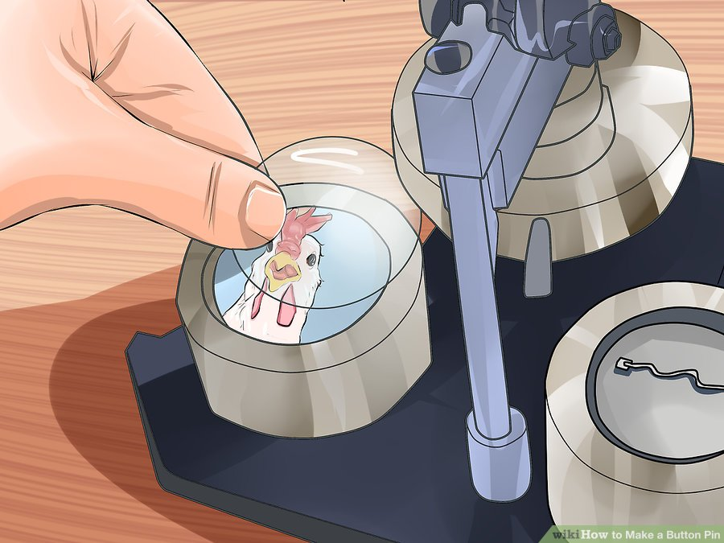
Step eight: place plastic cover on top of your picture

Slide 10
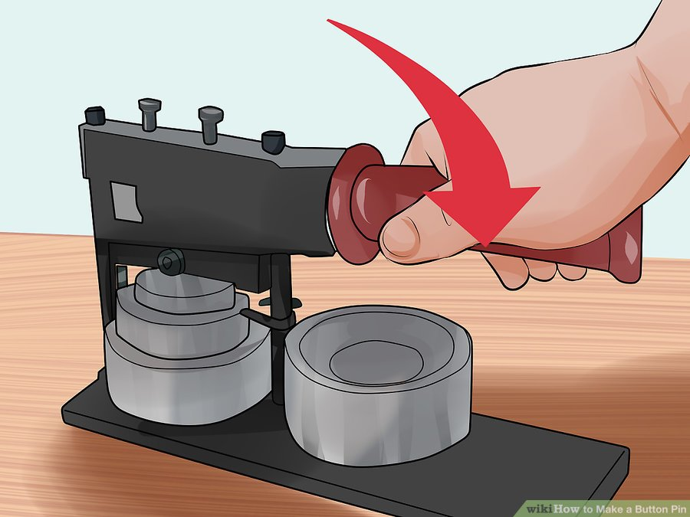
Step nine: pull handle down until you hear a click and release slowly

Slide 11
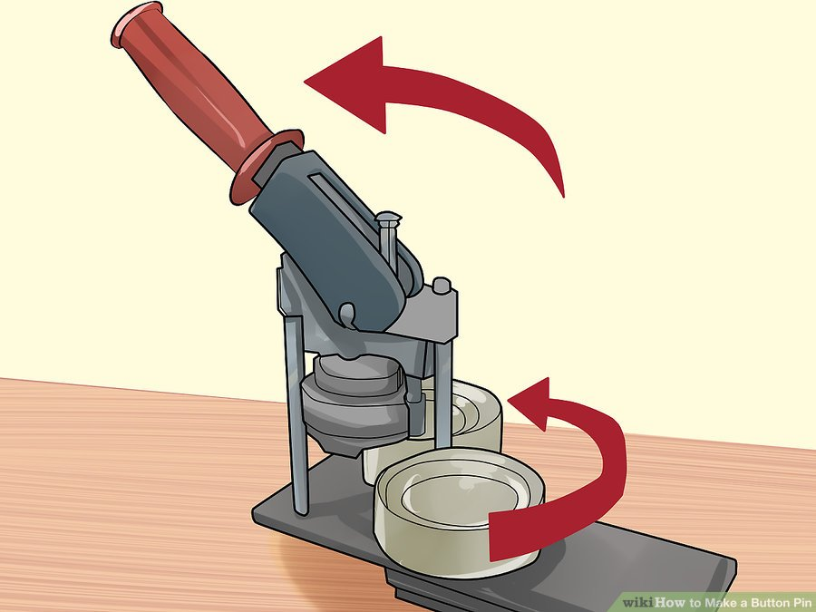
Step 10: switch machine to #2 position

Slide 12
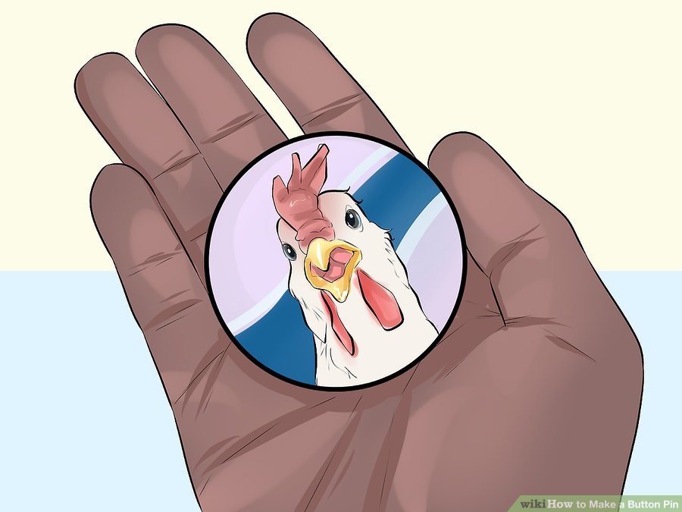
Step 11: Push button on the side to release your finished button

