Slide 1
Embroidery machine

Slide 2
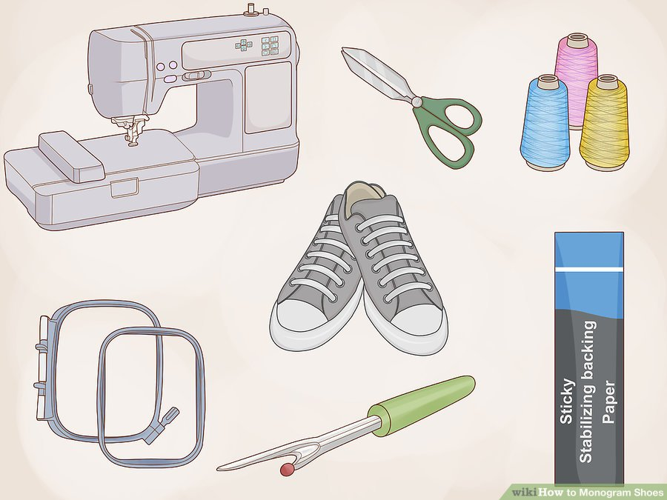
Step one: identify and gather needed materials to complete order.
Item to embroider

Slide 3
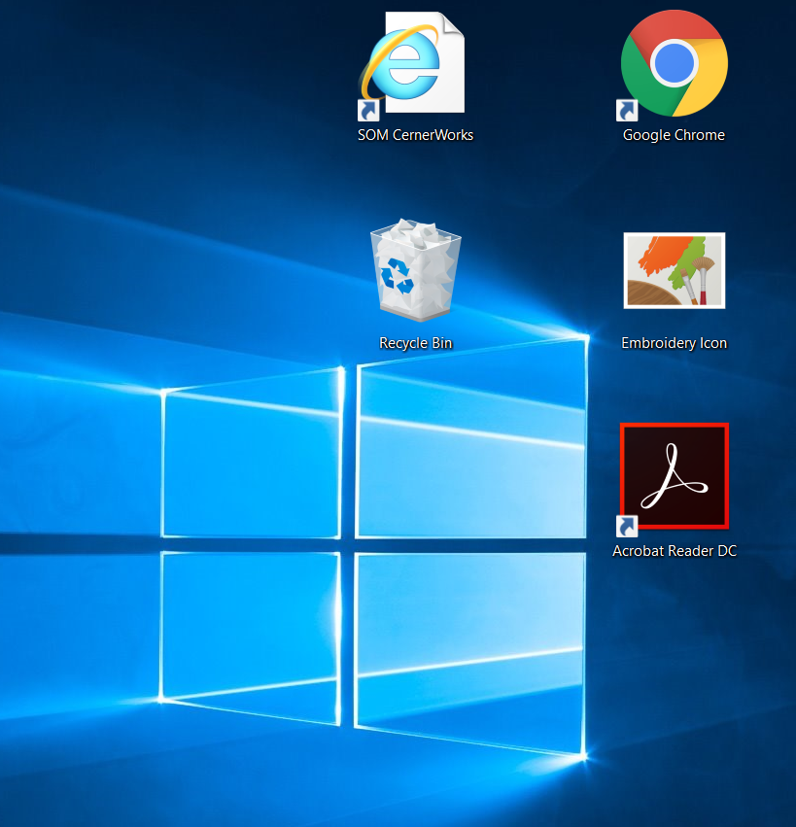
Step two: Open the Embroidery Icon on the computer

Slide 4
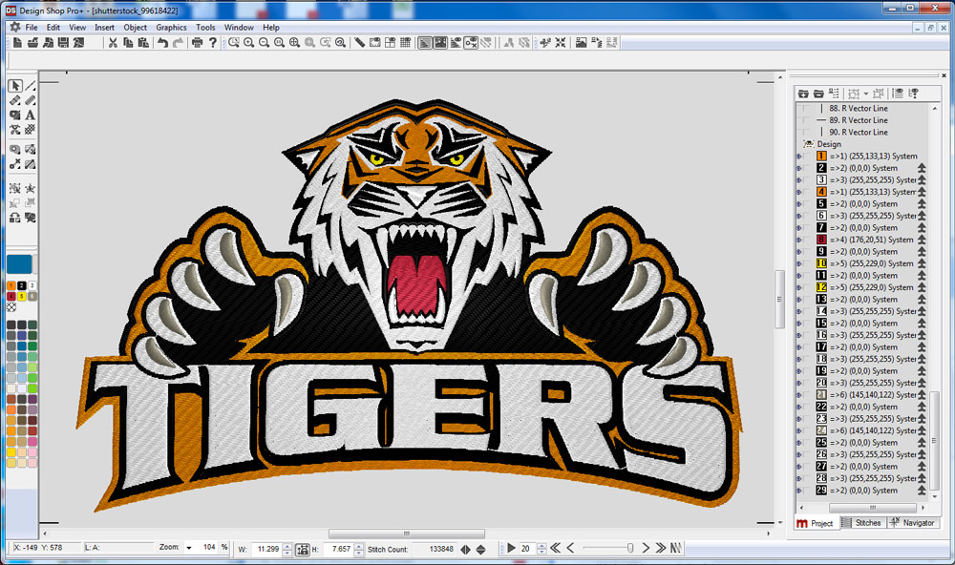
Step three: Create the design in the Embroidery Software (insert name)

Slide 5
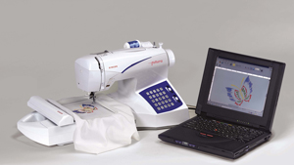
Step four: Send design to embroidery machine

Slide 6
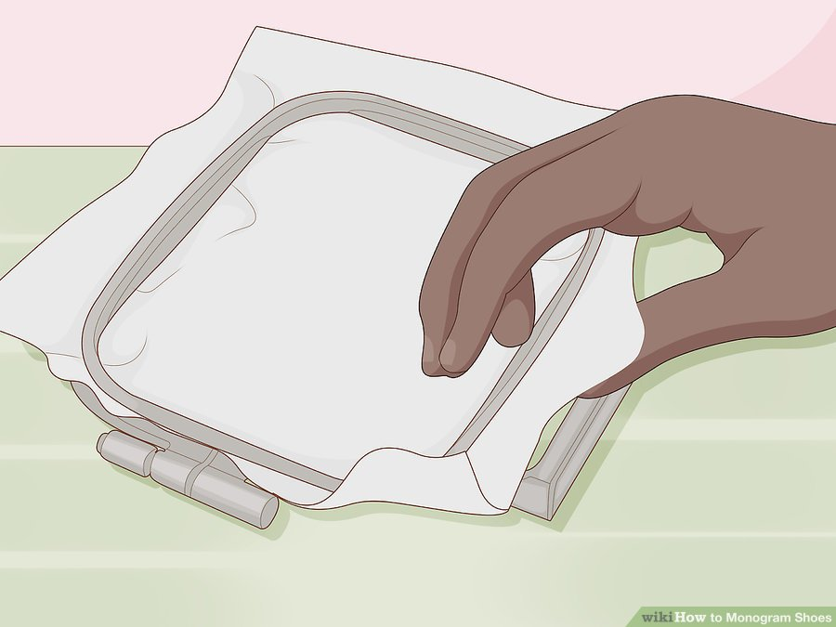
Step Five: Hoop the item in appropriate size frame

Slide 7
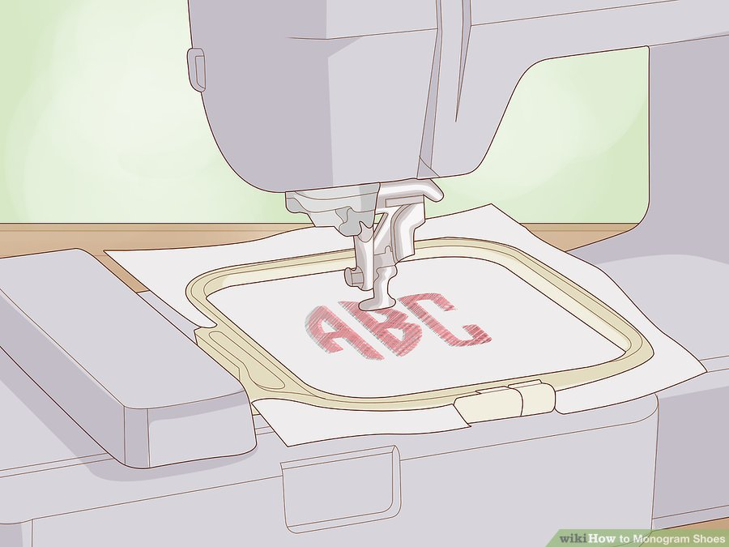
Step six: Attach the frame to machine

Slide 8
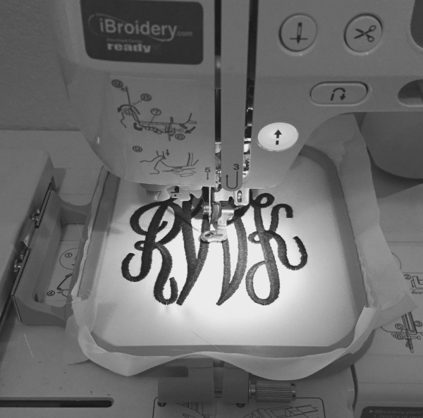
Step seven: On the machine, select the correct frame size

Slide 9
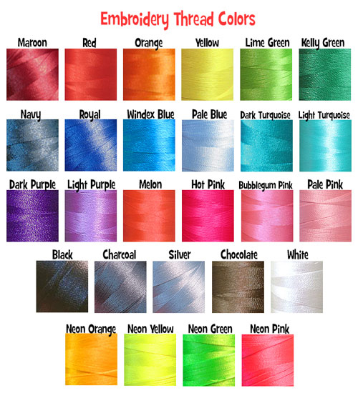
Step eight: Select the correct colored thread

Slide 10
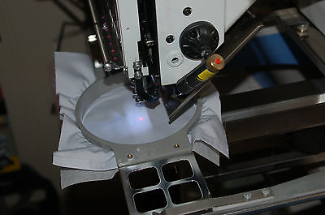
Step nine: Trace the design

Slide 11
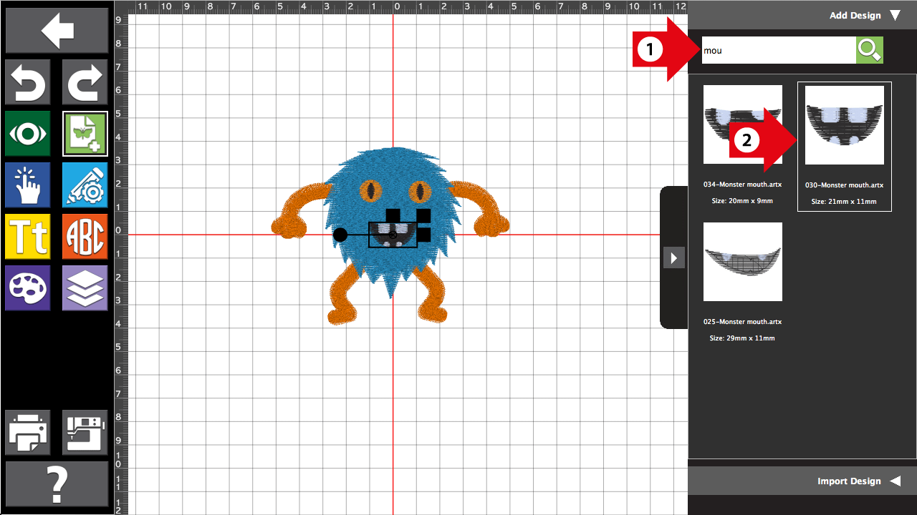
Step ten: Adjust the size on the computer if needed.

Slide 12

Step eleven: Press the start button

Slide 13
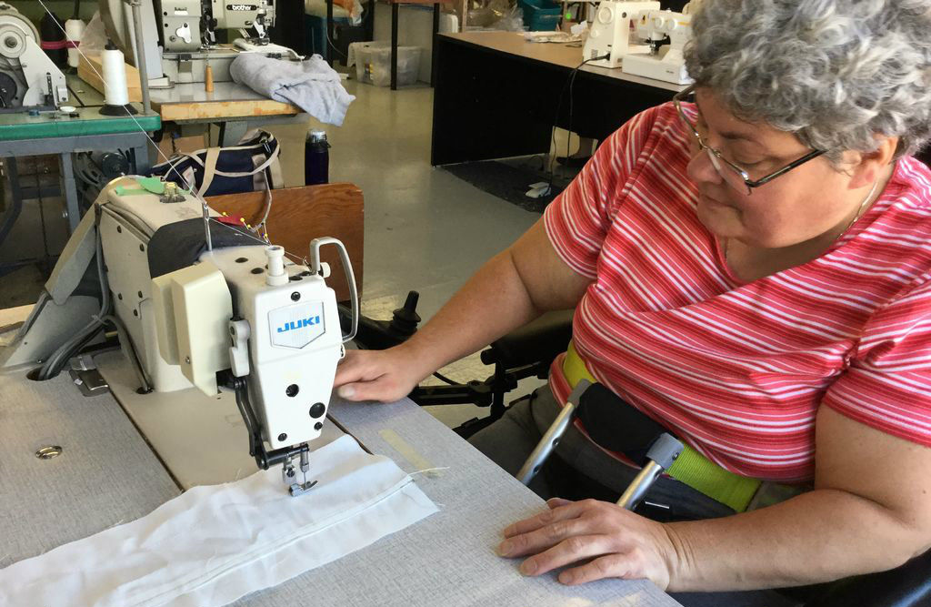
Step twelve: Monitor the machine until the design is complete

