Slide 1
Errand Service

Slide 2


Step one: Decide on which type errands you want to do

Slide 3
School Based Enterprise Ideas
Dry-cleaning drop off/pick up
Food Ordering and Pick Up for School Staff (local restaurants)
Farmers Market and Grocery Errands
Local Senior Citizens who may need errand service
Shopping Services
Pet Care Services
Gift Wrapping (especially around holidays)

Slide 4
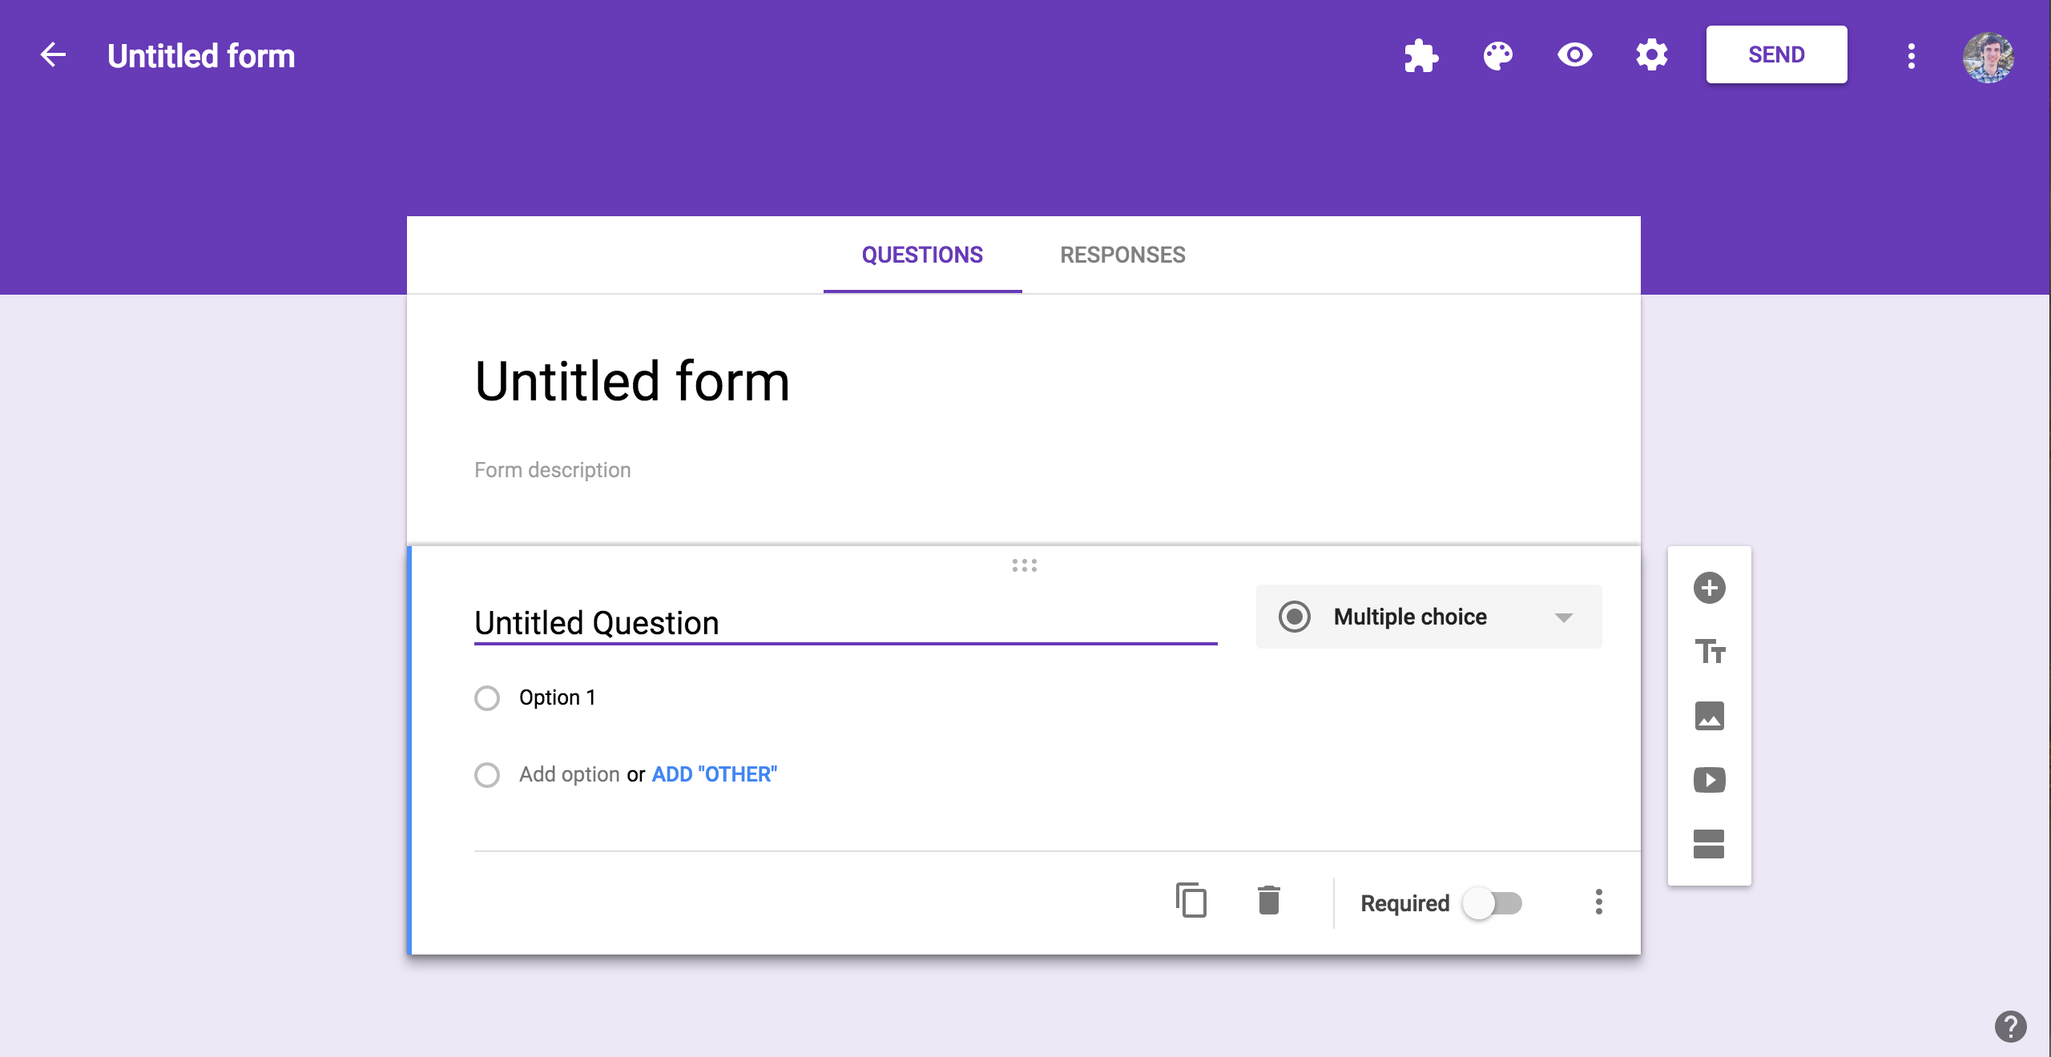
Step Two: Create an ordering system

Slide 5

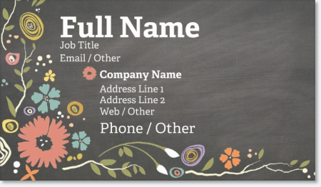
Step Three: Advertise and solicit business

Slide 6

Step Four: Map our your route

Slide 7

Step 5: Meet with prospective customers to determine needs

Slide 8

Be Dependable!

