Slide 1
Heat press

Slide 2
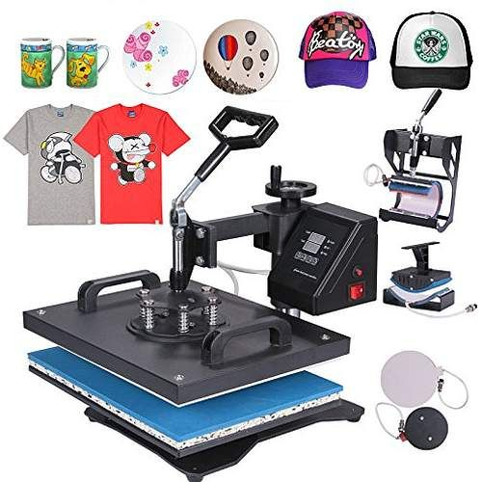
Step one: identify and gather needed materials to complete order

Slide 3
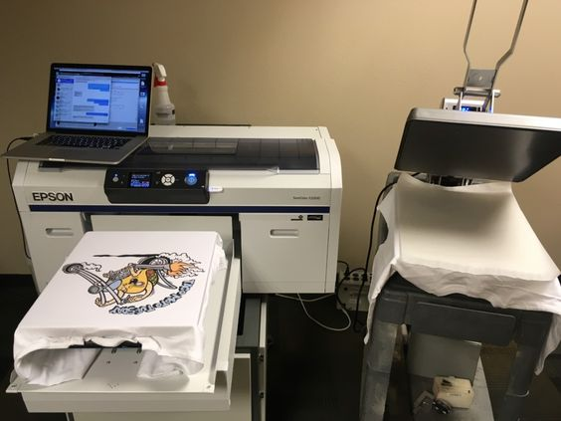
Step two: Open the heat press software on the computer

Slide 4
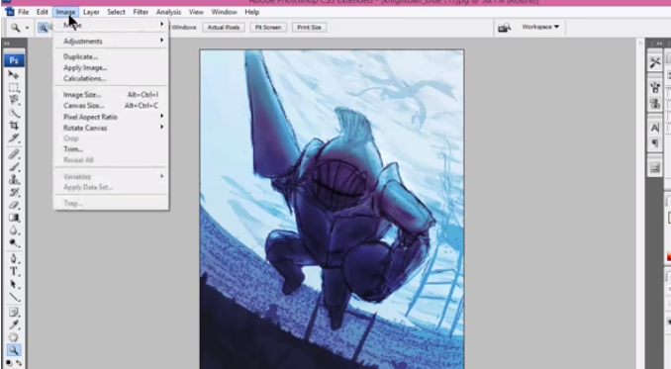
Step three: Create the design on the computer

Slide 5
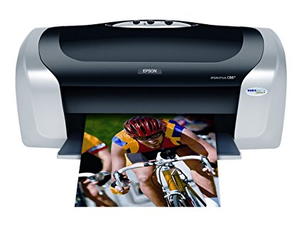
Step four: print using inkjet printer

Slide 6
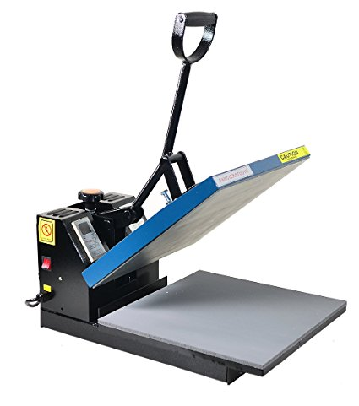
Step five: Power heat press machine on and allow it to warm up

Slide 7

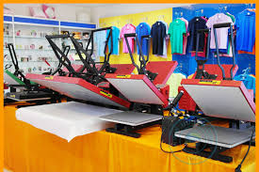
Step six: lay shirt flat on press

Slide 8
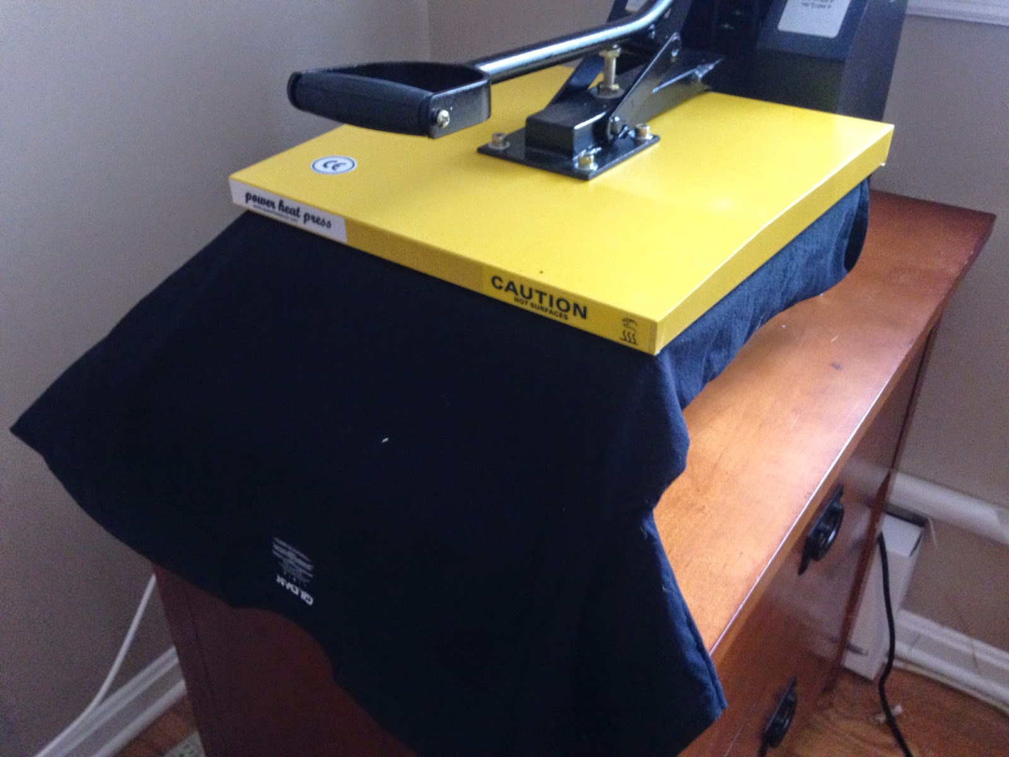
Step seven: preheat garment for a few seconds

Slide 9
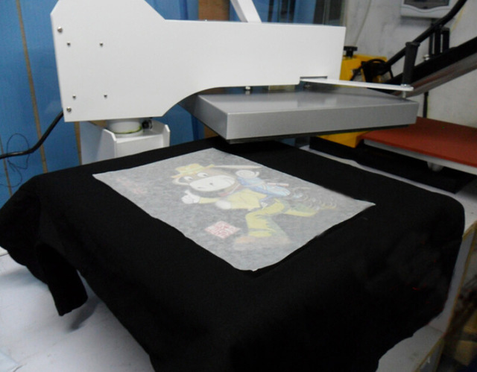
Step eight: place transfer paper

Slide 10
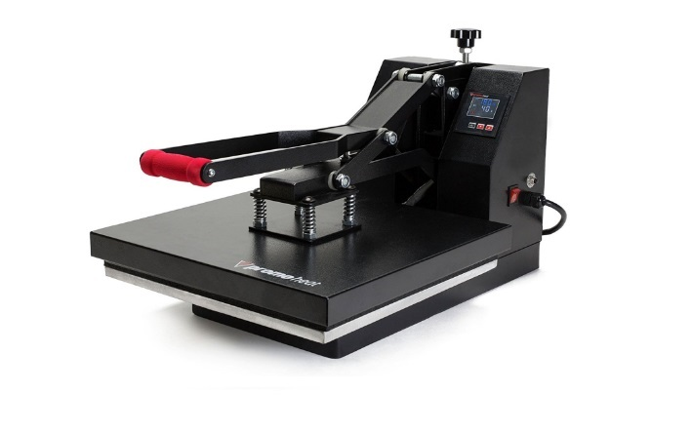
Step nine: pull the handle (arm of the machine) down and lock

Slide 11

Step ten: when timer is complete lift arm up

Slide 12
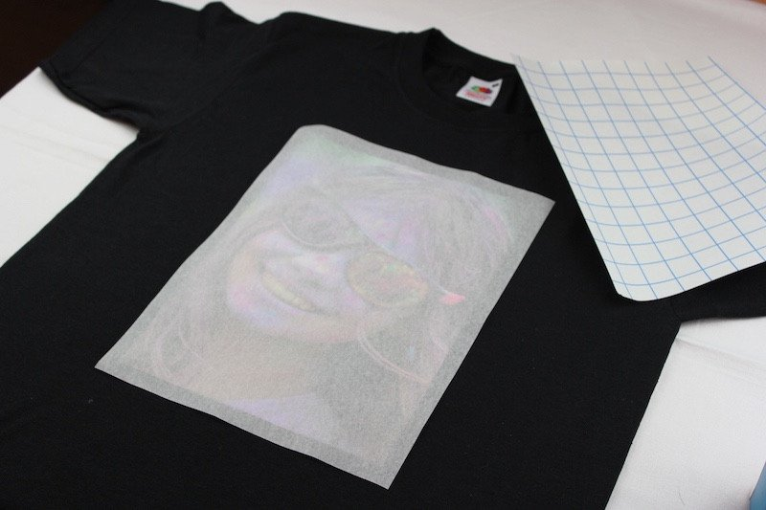
Step eleven: remove shirt from heat press

Slide 13
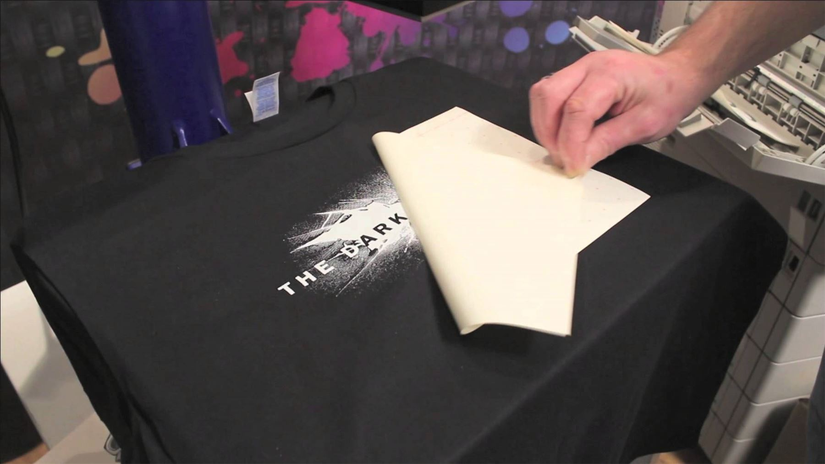
Step twelve: peel hot paper quickly and allow shirt to cool

