Slide 1
Painting parking spots- service

Slide 2
Step one: identify and gather materials to complete order
Paint: Purchase various colors Don't forget the paint tray and paint can opener. Paint with any household interior or exterior paint. Latex paint works the best. Spray Paint should not be used.
Chalk: Use chalk to draw the outlines before you paint. Chalk will wash off.
Paint Brushes and Rollers: You will need a lot of paint brushes and rollers and to have at least one for each color that will be used.
Painters Tape: Use the painters tape to outline the spot so you don't paint over the lines or on your neighbors spot. You could also use painters tape to outline your design but keep in mind that it doesn't stick on that well to the ground.
Hula hoop (optional): A hula hoop is a great tool to use if you are having any sort of larger circle incorporated into your design
Broom or Leaf Blower: It's important to clean off your spot before you even start painting it
Cloths or paper towels: Painting is messy so make sure you have something to wipe your hands on like a old cloth or paper towels.
Towel: It's not too comfy sitting on the ground for long periods of time so bring a towel to sit on.
Paint Roller Extension Pole: This is super important to expedite the process of painting the background color and super helpful so you don't have to bend down or sit to paint the majority of the spot.

Slide 3
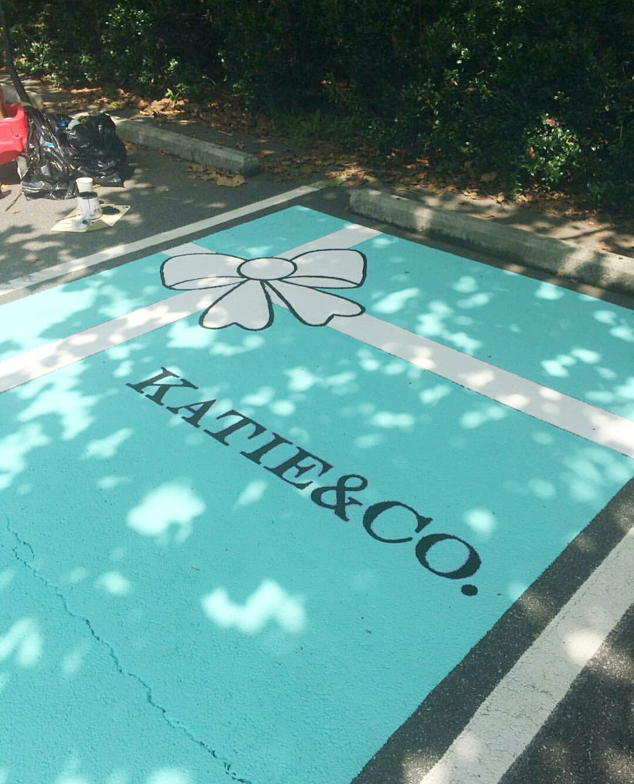
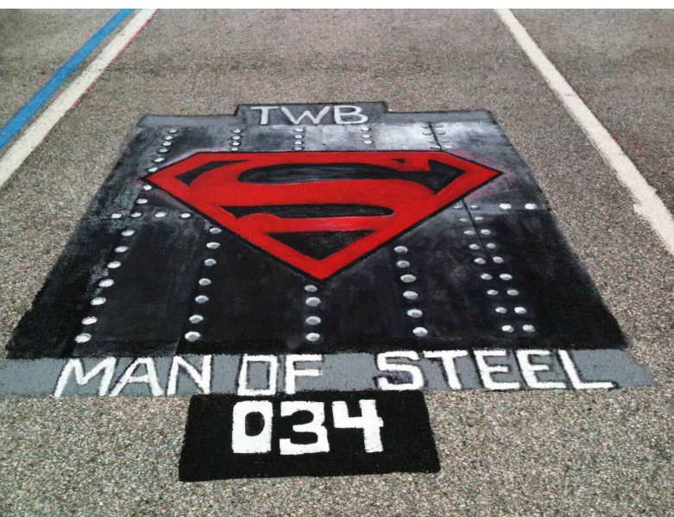
Step two: Once your customer has Chosen a design, draw it out to make sure that you can do it.

Slide 4
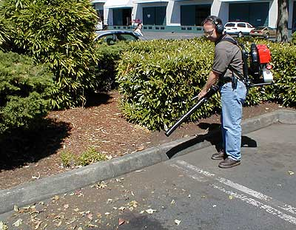

Step three: Clean off parking spot

Slide 5
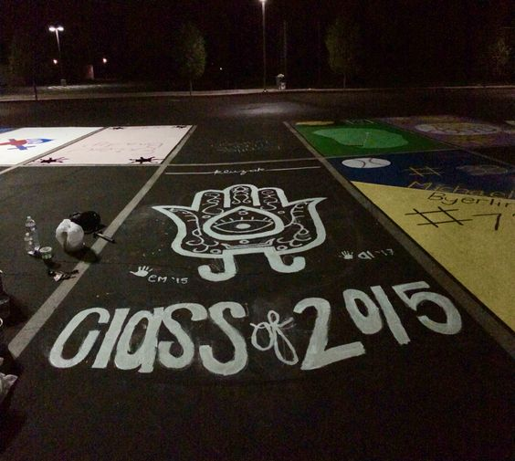
Step four: Chalk out the design

Slide 6
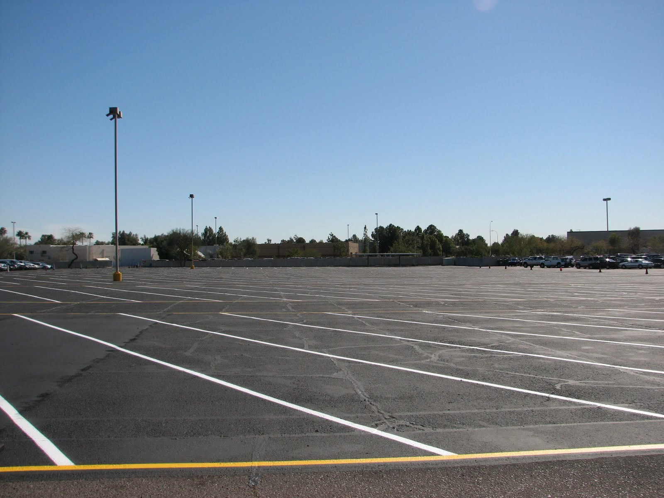
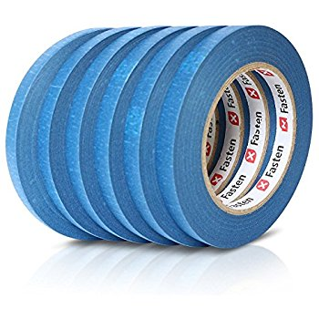
Step five: Tape off the parking spot prior to painting

Slide 7
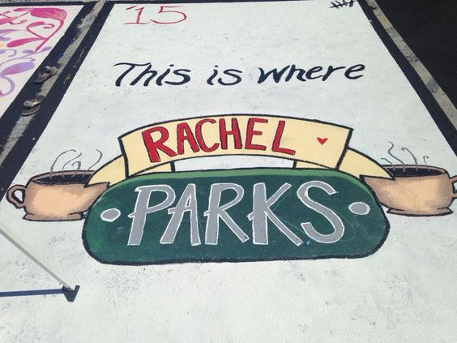
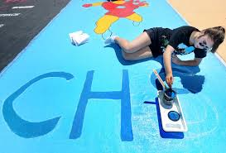
Step seven: Paint the parking spot

Slide 8

Step eight: Get Customer feedback

