Slide 1
School spirit bracelets

Slide 2
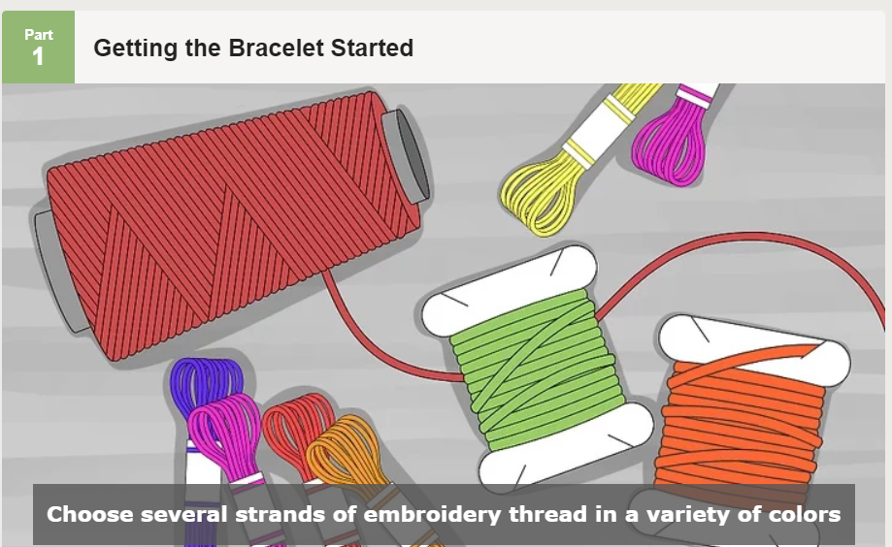
Step One:
Choose as many strands of thread as you like, as long as you're using three or more. Go for color combinations that you think would make a pretty pattern. Get creative! If you only use one color of thread, you won't be able to create a pattern. Four to six strands will make a narrow bracelet, and 6-10 strands will make a thicker one. The more strands you chose, the wider the bracelet will be.

Slide 3
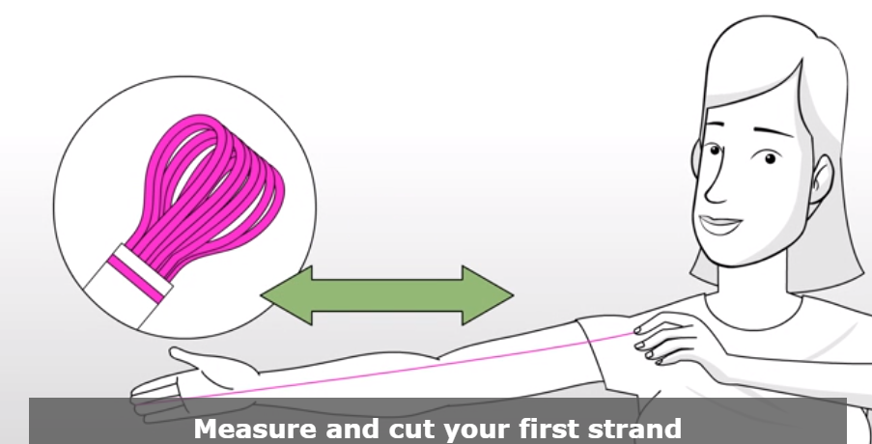
Step Two:
Measure a length of thread slightly longer than the distance from your fingertip to your shoulder and then cut it. That way, you’ll have enough thread for the bracelet to stretch around your wrist to create a pattern. It’s better that your string is too long than too short, so cut a longer string when in doubt.

Slide 4
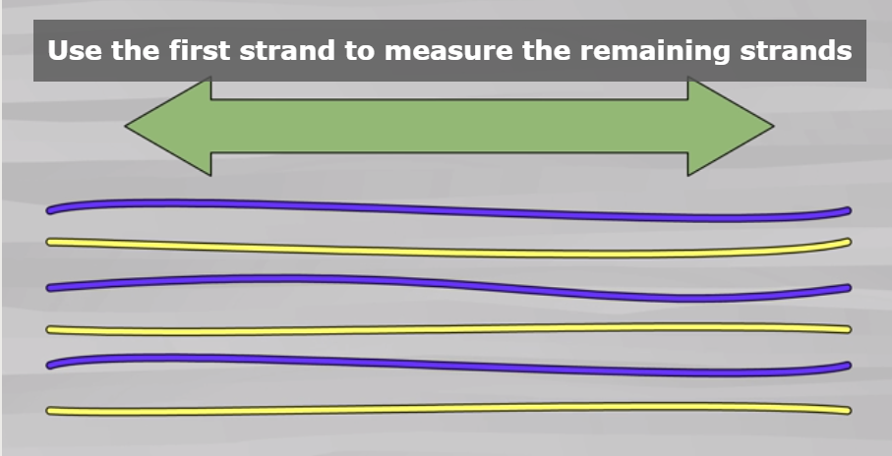
Step Three:
Use the first strand to measure the remaining strands. You want a nice, even bracelet. Hold the cut strand up to the remaining strands and cut them to be the same length as this strand

Slide 5
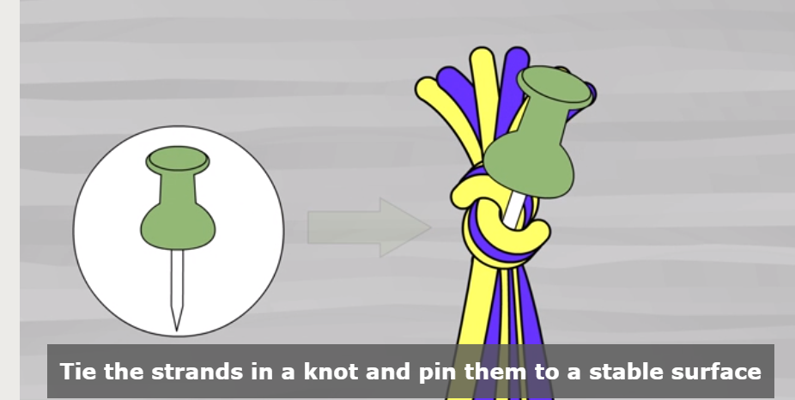
Step Four:
Tie the strands in a knot and pin them to a stable surface. You can pin the bracelet to your pants, to a pillow, or to another stable cloth surface that you won't damage. If you can’t find a safe surface, look no further than your toes! Tie the bracelet around a toe for stability. You can also tape it to a surface, or close it in a drawer. However, pinning is better than taping because the pin keeps your bracelet from wriggling out of the proper position.

Slide 6
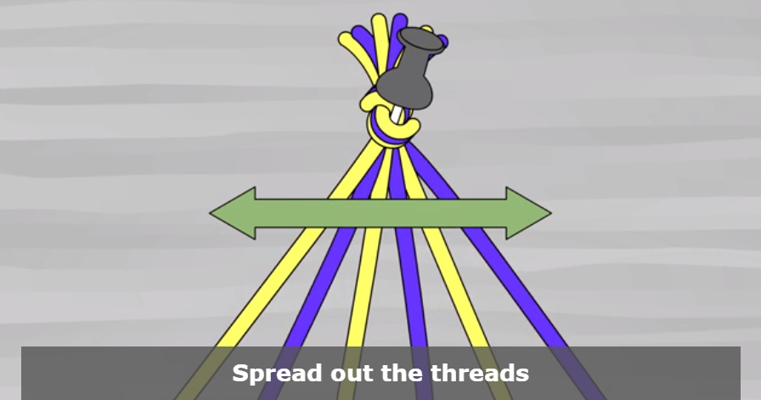
Step Five:
Spread out the threads. Before you start getting crafty with knotting, spread out the threads so that the colors are in the order you'd like the striped patterns to be. To make the knotted end of your bracelet less bulky, try not to cross the threads over one another too much.

Slide 7
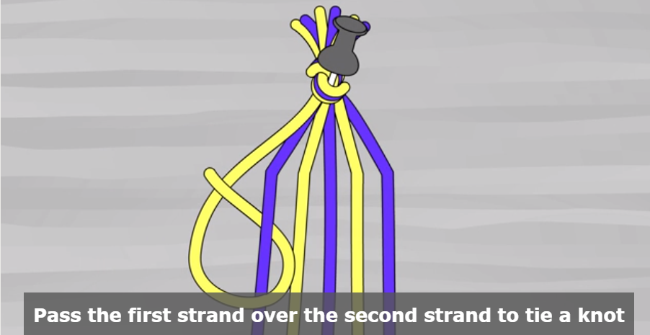
Step Six:
Pass the first strand over the second strand to tie a knot. You will need to make the "half-hitch" knot to do this correctly.
First, move the first thread over the top of the 2nd thread. Make sure to leave some of the first strand on the other side so that there is a loop.
Bring the first thread behind the second thread and then pull it through the loop.
Hold the second thread firmly while you pull on the first thread. As you do this, a knot will move up to the top of the second thread. Now, you’re done with your first knot. Not so bad, right?

Slide 8
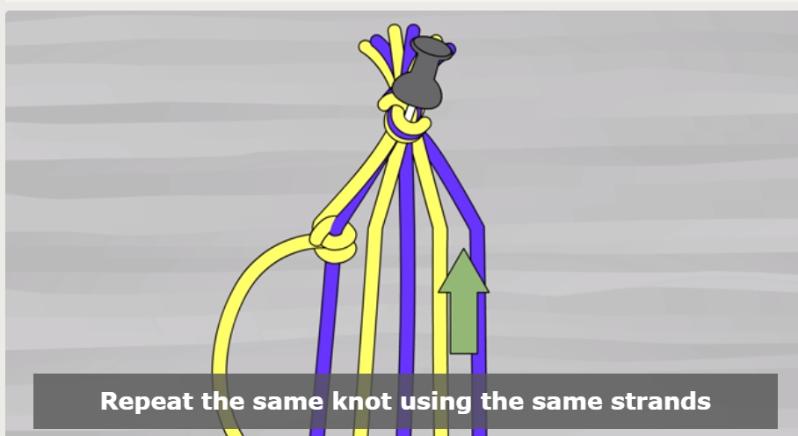
Step seven:
Repeat the same knot using the same strands. After you make the second knot with the first and second strand, you will need to use the first strand to make two knots in the third strand, and then the fourth, and so on. Keep going until there are two knots on every strand. Make sure that you pull on the thread just until you feel resistance. Be careful not to pull too tight! If some knots are tighter than others, the bracelet will look lumpy and uneven instead of neat and sleek.
Continue knotting the first strand around each successive thread, moving from left to right, until you've knotted all of the strands and the first strand is in the far right position.

Slide 9
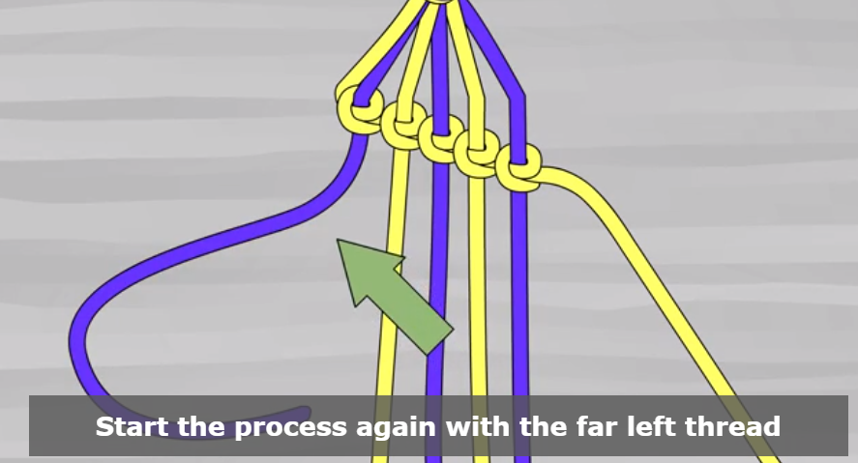
Step eight:
Start the process again with the far left thread. Congrats, you’ve made it through the first round of knots! Let’s keep going. The far left thread will be the new first thread. Every thread will end up on the right when you're done, and you'll start with a new color of thread every time. Repeat the double knot technique with the far left strand, moving from left to right until the strand is in the far right position

Slide 10
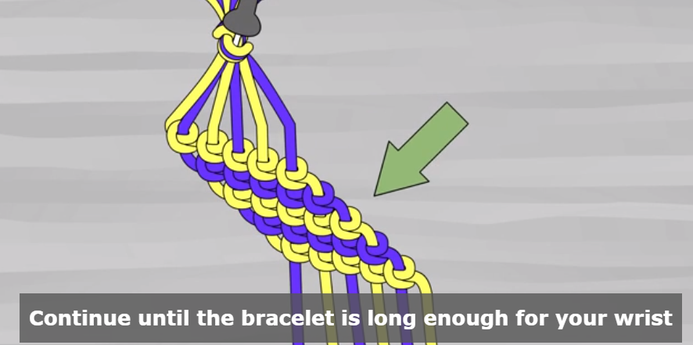
Step nine:
Continue until the bracelet is long enough for your wrist. You’ve made an awesome bracelet, so you should make sure it fits! Wrap it around your wrist. There should be enough extra room that you (or the person who will wear the bracelet) can fit about two fingers in next to your wrist.

Slide 11
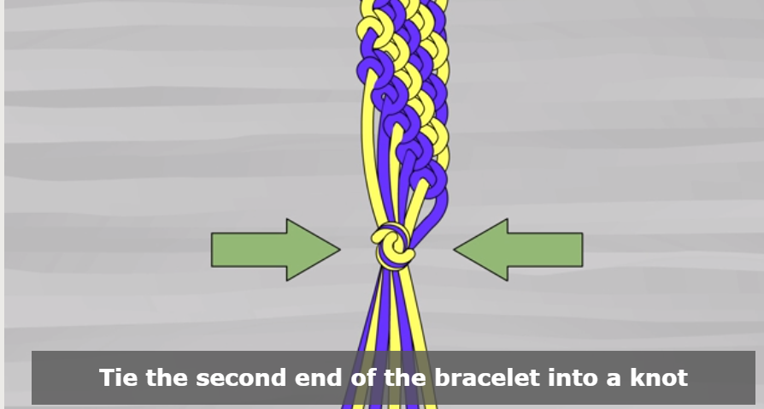
Step ten:
Tie the second end of the bracelet into a knot. Make sure that the knot doesn’t take up any of the length you need to wear the bracelet.

Slide 12
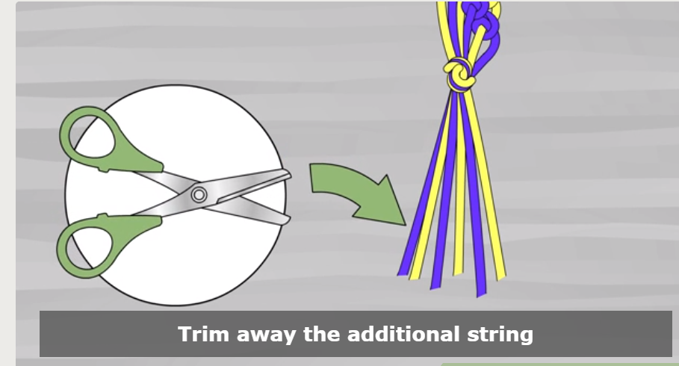
Step Eleven:
Trim away the additional string. If you still have a lot of string left over, you can snip it off with a pair of scissors.

Slide 13
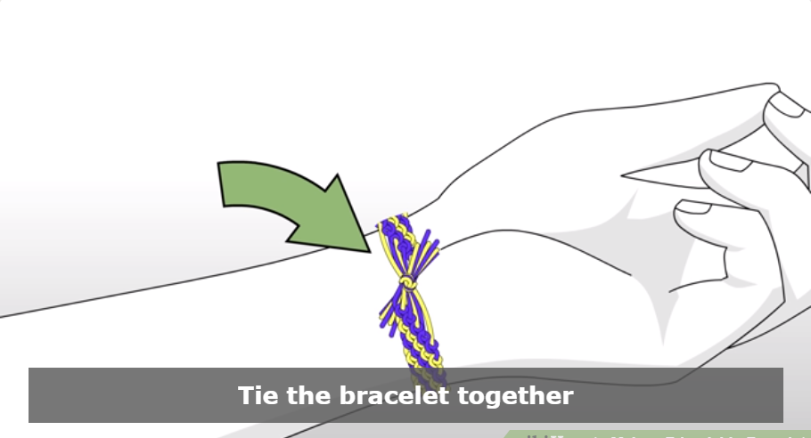
Step Twelve:
Tie the bracelet together. Now that you've knotted both ends of the bracelet, just tie the strands of the bracelet together and you’re ready to rock it! If you want your bracelet super snug, have a friend knot the bracelet after you put it on

