Slide 1
Slogan Game
Can you guess the product or business?

Slide 2
The Happiest Place on Earth

Slide 3


Slide 4
Bet You can’t eat just one

Slide 5


Slide 6
The taste of a new generation

Slide 7


Slide 8
Get your own box

Slide 9
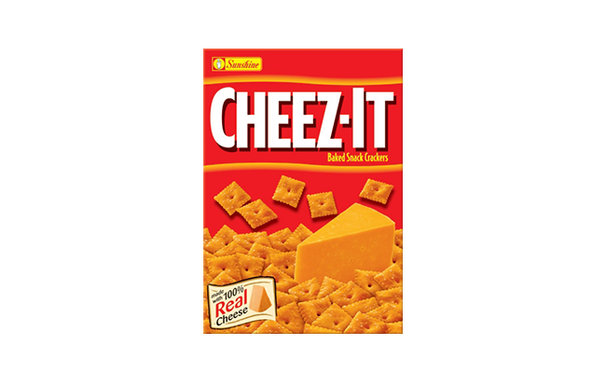

Slide 10
The best a man can get

Slide 11


Slide 12
Think different

Slide 13


