Slide 1
Vinyl Cutting machine

Slide 2
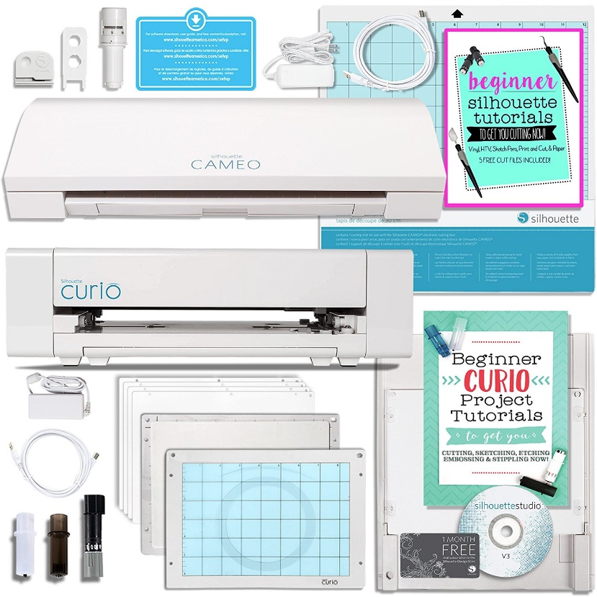
Costs to Consider- Where to start

Slide 3
Vinyl Cutter
A vinyl cutter is nothing more than a computer controlled machine.
They often look and behave a lot like printers, but instead of having a pen reproducing your work onto printer paper, vinyl cutters use a blade to cut your design into certain materials.
The software you use to design will export your creation from your computer to the vinyl cutter, controlling the movements of the blade like it would do with a printer.

Slide 4
Software
The fastest way to improve your creations is to improve the design before it gets sent to the machine — i.e. in the software.
This involves practicing your design skills and making use of increasingly sophisticated software.
Three of the most popular design tools are:
CorelDraw
Adobe Illustrator
AutoCAD

Slide 5
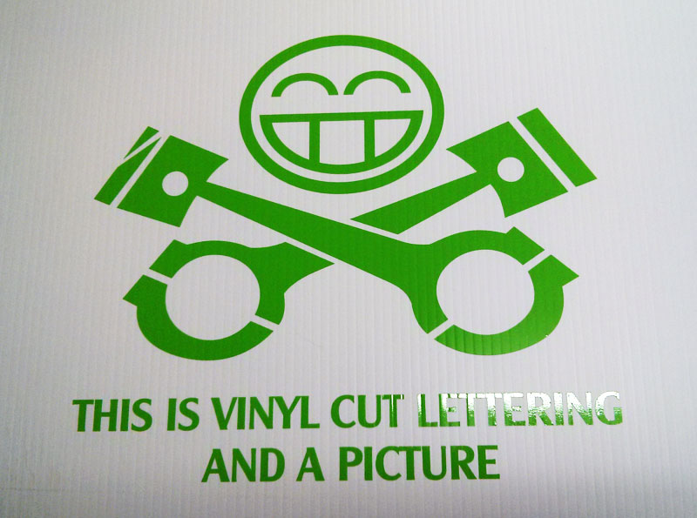
Step one: Create your artwork
How easy or hard this is- will depend on your machine and software.
Aside from simple fonts already in the Windows or Mac operating system, you can purchase additional fonts, or you can purchase artwork that is Vinyl Cutter Ready Vector Art such as the Mega Vector Art Collection

Slide 6
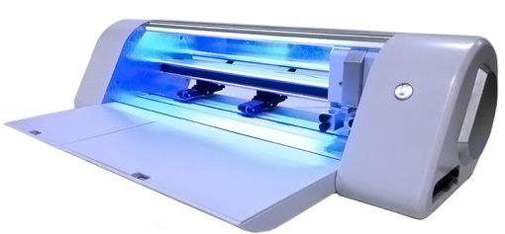
Step two: Bring your artwork into a vinyl cutting program
Once you have created artwork in a program such as Illustrator, Corel Draw or InkScape, you will need to import it into a vinyl cutter program. There are several vinyl cutter programs available on the market. The most common is Flexi Starter 10 (and numerous private label versions of it) followed by programs like SignCut. These programs will lay out your artwork on your vinyl, create weeding lines, create a weeding frame or box, allow you to make copies in rows and columns, scale and rotate, layer the cuts and do several other functions and finally, send the cutting commands to the vinyl cutter.

Slide 7
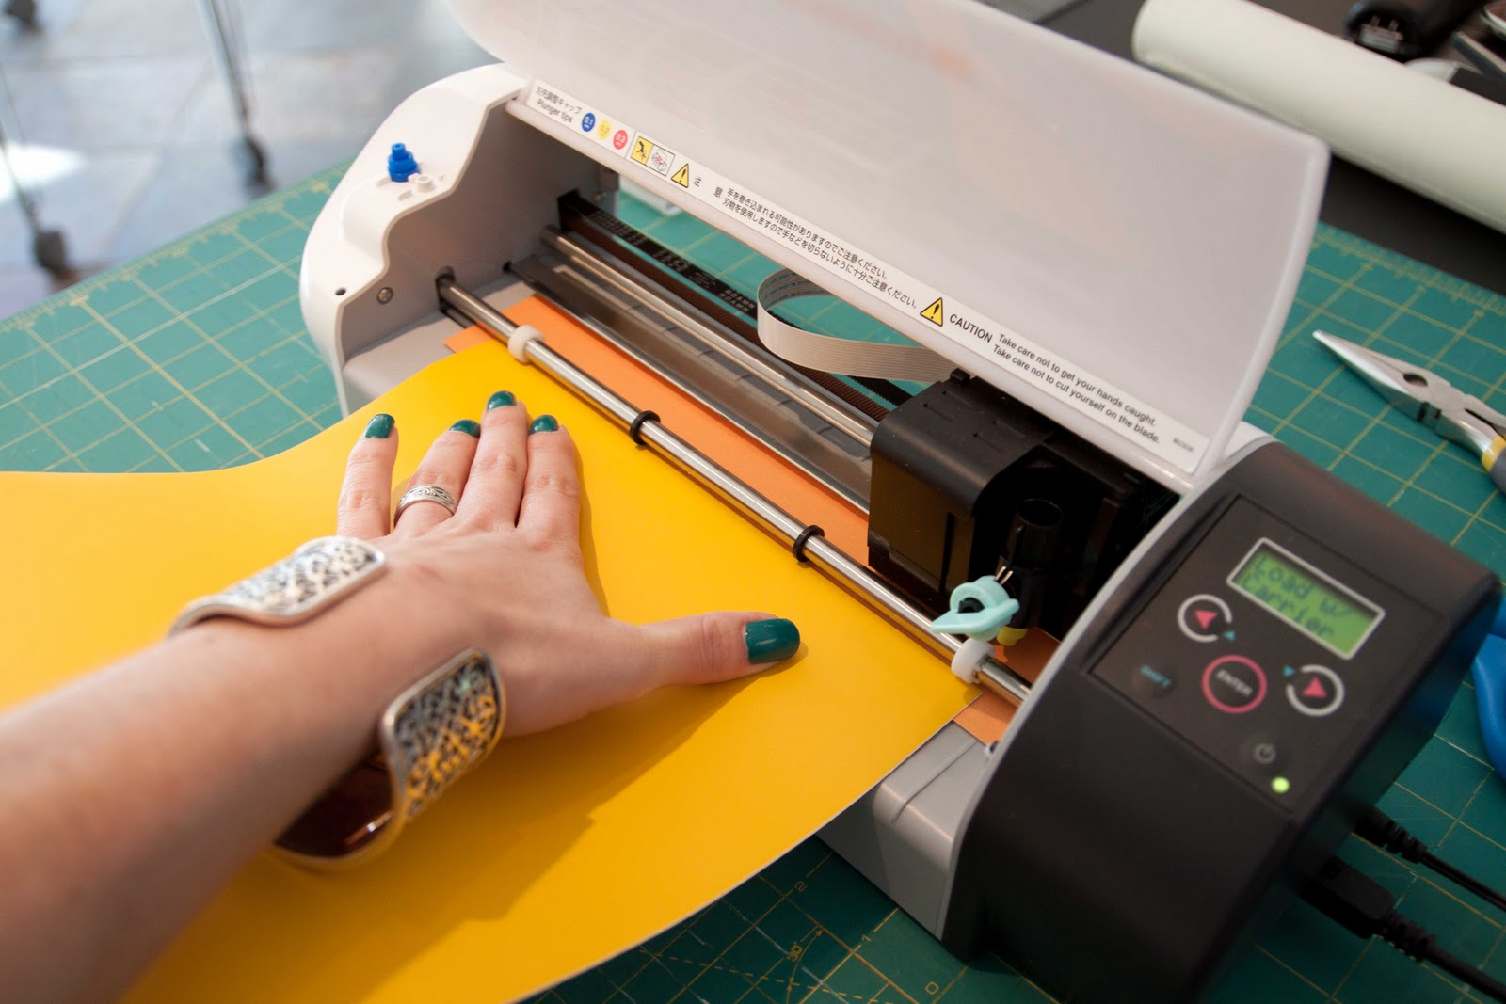
Step three: Load your materials
Basically, vinyl material is roll fed into a vinyl cutter and hangs off the back side of the cutter on rollers or on a roller bar. Feed the vinyl under the pinch rollers and on top of the roller bar and then release the rollers to hold the vinyl in place.

Slide 8
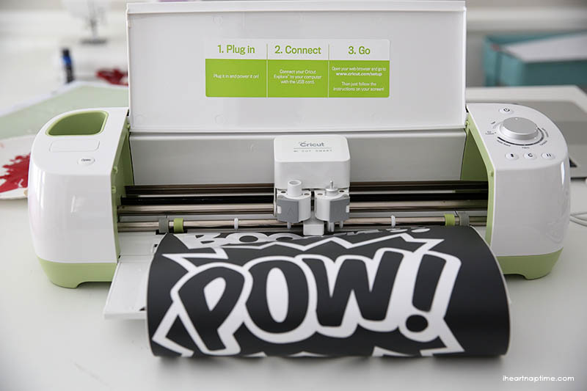
Step Four: Cut
Cut your artwork. Use the cutting feature of your sign cutting software to send your artwork to the vinyl cutter. Cutting your artwork can take as little as a few seconds to several hours depending on complexity. Most simple signs and decals take just a few minutes.

Slide 9
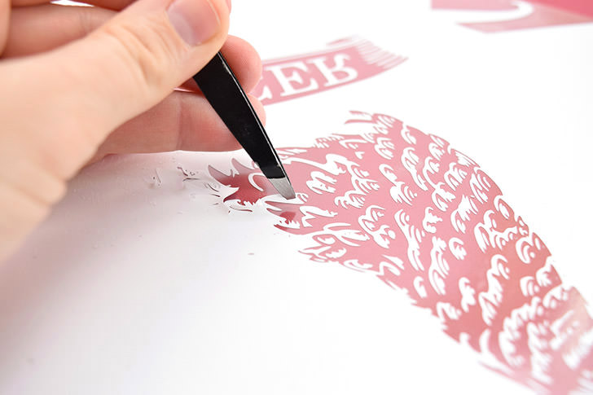
Step Five: Weed your Vinyl
Weeding is the process of removing material that you don't want in your graphics. The smaller the features in your graphic, the more challenging weeding can become.
This is when you need tweezers!

Slide 10
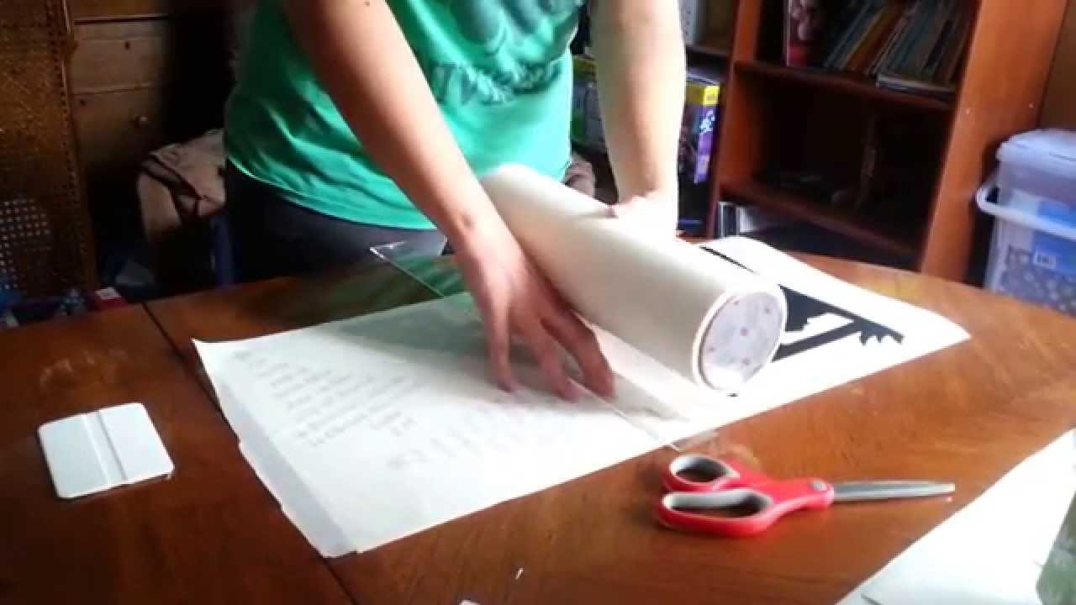
Step six: Apply transfer tape
Apply transfer tape, masking tape, contact paper, etc.
With your image weeded, the next step to take will be to transfer your image from the release liner to the target surface.

Slide 11
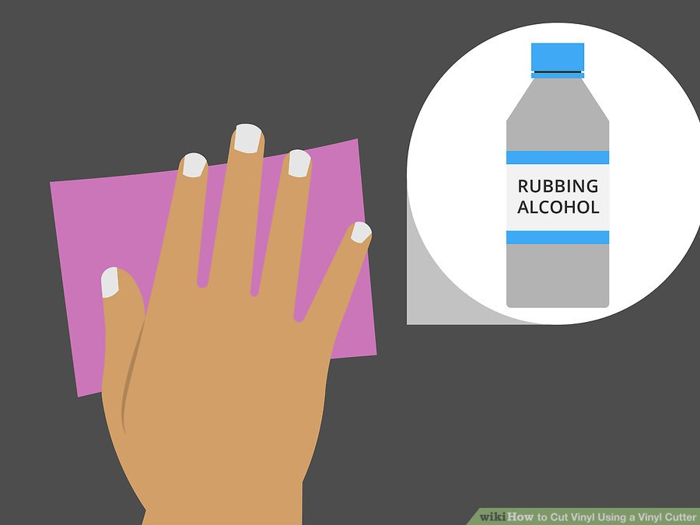
Step seven: Prepare your surface
Prepare your target surface.
Your target surface should be prepared by cleaning with rubbing alcohol or other similar cleaner to remove grease, oil and dirt.

Slide 12
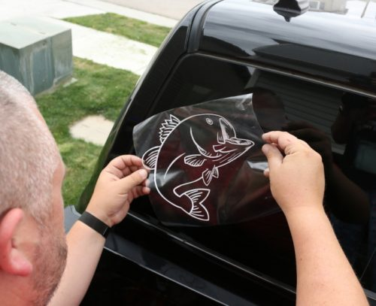
Step eight: Apply your graphics
Apply your graphics
Peel the transfer tape away from the release liner and your graphics should come with your transfer tape.
If they don't, push the transfer tape back down and use your squeegee again to stick the transfer tape to the decal.
Take this decal and apply it to the target surface. From there, use your squeegee to smooth your decal on your target surface removing all air bubbles.

