Slide 1

Saddle Up for the Journey: Navigating Life After High School
Hannah Mathis, LMSW
Director of Youth Services
Notes:
Hannah
Hello and welcome
Introductions
Purpose of the training

Slide 2

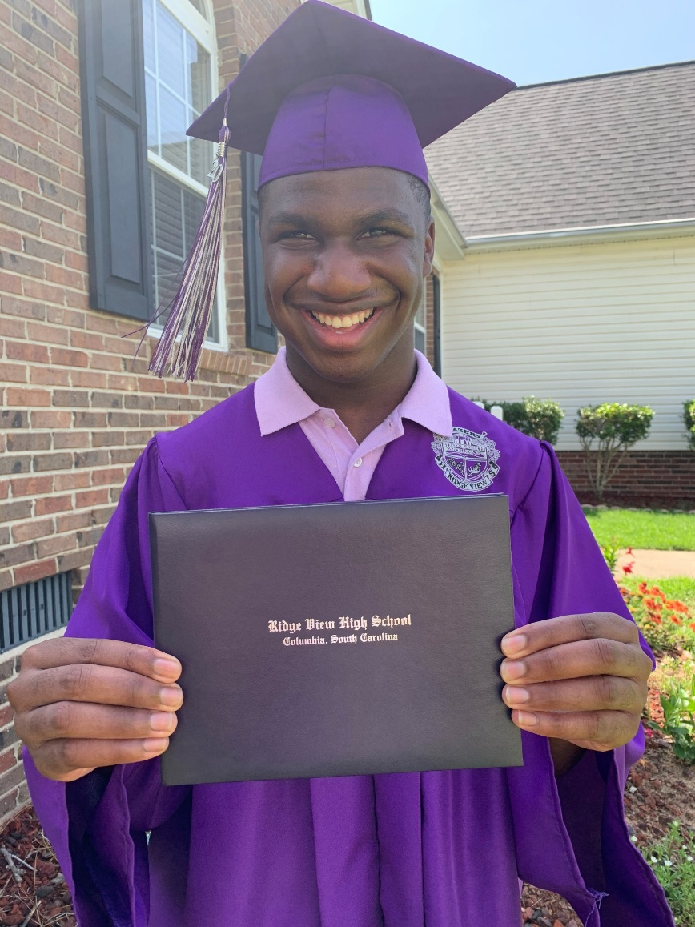



History, Progress, and the Future of FCSC
1990
2009
2015
Notes:
Family Connection of SC has provided parent-to-parent support to families for more than 30 years! We are a "Parent Center" with 3 federal designations for SC. Family Connection of SC is SC’s Parent Training and Information Center (SC PTI) under the US Department of Education; SC’s Family- to-Family Health Information Center (SC F2F HIC) under HRSA; SC’s Family Voices; and Parent-to-Parent USA, SC Affiliate.
And in order to qualify to apply for any of these designations- you must be a "Parent Center" - A Parent Center must be staffed by primarily parents of a child with a disability—across ALL disabilities- from ages birth to 26y/o.
Each PTI across the US offers trainings, however many may implement their services differently—so for instances if you have worked in another state, or even in SC before 2015- you would have worked with a different Nonprofit here and services are designed to meet the needs of the families in each state.

Slide 3
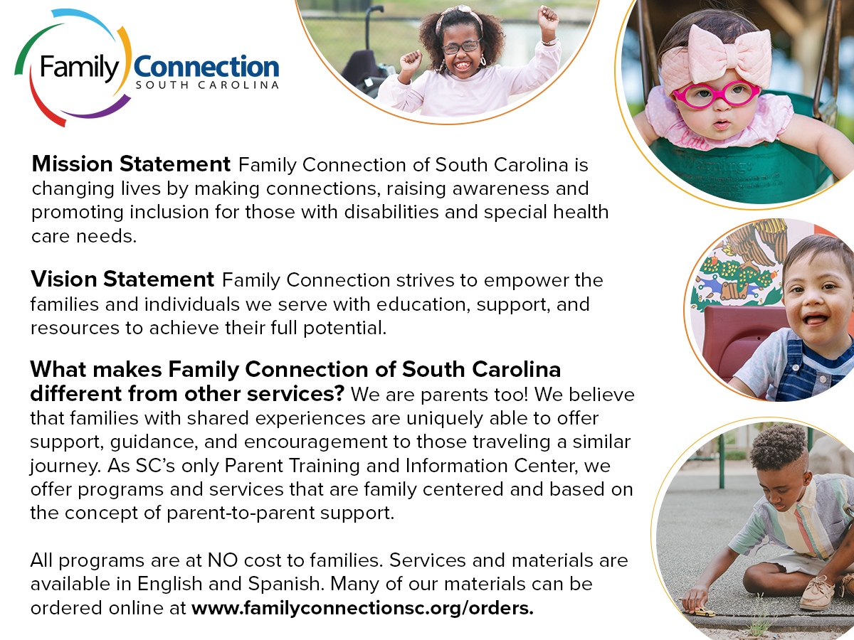
Notes:
Under the IDEA (Individual with Disabilities Act) the work of Family Connection of Sc respects and helps families and the community understand the "intent" of the law which is to ensure that from the governing body, to the direct practitioner that the 'parent' 'family' voice is heard when it comes to questions, concerns, and processes directly related to their diagnosis, disability, suspected disability, and/or special health care need. Family Connection of SC can help you and your families navigate through what can be complicated systems as well as provide one-to-one emotional support that is fueled by parents on our staff who also have a child with a diagnosis or special health care need.
We work with organizations who serve families to ensure all parents have access to information and resources – with an intentional focus on family groups where there are typically service gaps – including families who’s primary language isn’t English, military connected families who are new to South Carolina and families with housing instability …which you will hear more from our colleagues at the SC Department of Education about how we are partnering to serve students with disabilities who are experiencing homelessness.

Slide 4

Why Family Connection of SC?

Slide 5

FAQ’s from Families on Navigating The Journey
What are decision making options and what do I do next?
Can my student get a job?
Can my student go to college or a technical school?
What are resources we wish we had known about sooner?
Who is here to support me whenever my student is no longer in high school?

Slide 6
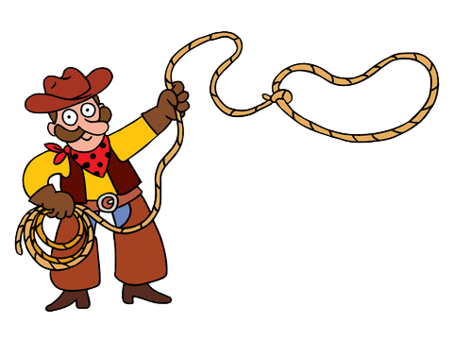
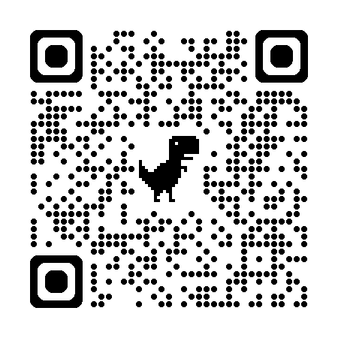
Decision Making Options
Least to Most Restrictive
Supportive Decision-Making
Power of Attorney (POA)
Guardianship/Conservatorship
CPIR Age of Majority
Notes:
CIPR website link - talks about age of majority
This is not a comprehensive nor in-depth overview of the decision-making options available in SC. If you have further questions about each of these, please feel free to reach out to an attorney. We will also have a follow up tip sheet that briefly speaks about all these options. Our goal with this overview to help parents make sure they are informed and educated about all the options available.
When discussing decision-making with families, it is important not to assume that guardianship is the best or only option. Options listed here range from least restrictive to most restrictive. Supported decision-making agreements are the least restrictive, followed by powers of attorney, with guardianship being the most restrictive.

Slide 7
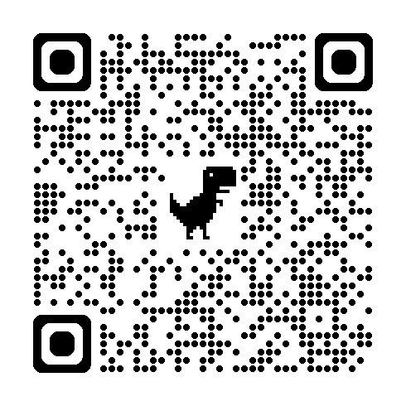
Decision Making Options
Adult Students with Disabilities Educational Rights Consent Act:
At 18: Ask, don’t assume.
Ask: Who is making educational decisions?
Ask: How does this student communicate their choices?
Ask: What support does the student need to participate?
Ask: How can we keep the student at the center of the process?
Notes:
https://www.disabilityrightssc.org/adult-students-with-disabilities-educational-rights-consent-act/
This is not a comprehensive nor in-depth overview of the decision-making options available in SC. If you have further questions about each of these, please feel free to reach out to an attorney. We will also have a follow up tip sheet that briefly speaks about all these options. Our goal with this overview to help parents make sure they are informed and educated about all the options available.
When discussing decision-making with families, it is important not to assume that guardianship is the best or only option. Options listed here range from least restrictive to most restrictive. Supported decision-making agreements are the least restrictive, followed by powers of attorney, with guardianship being the most restrictive.

Slide 8
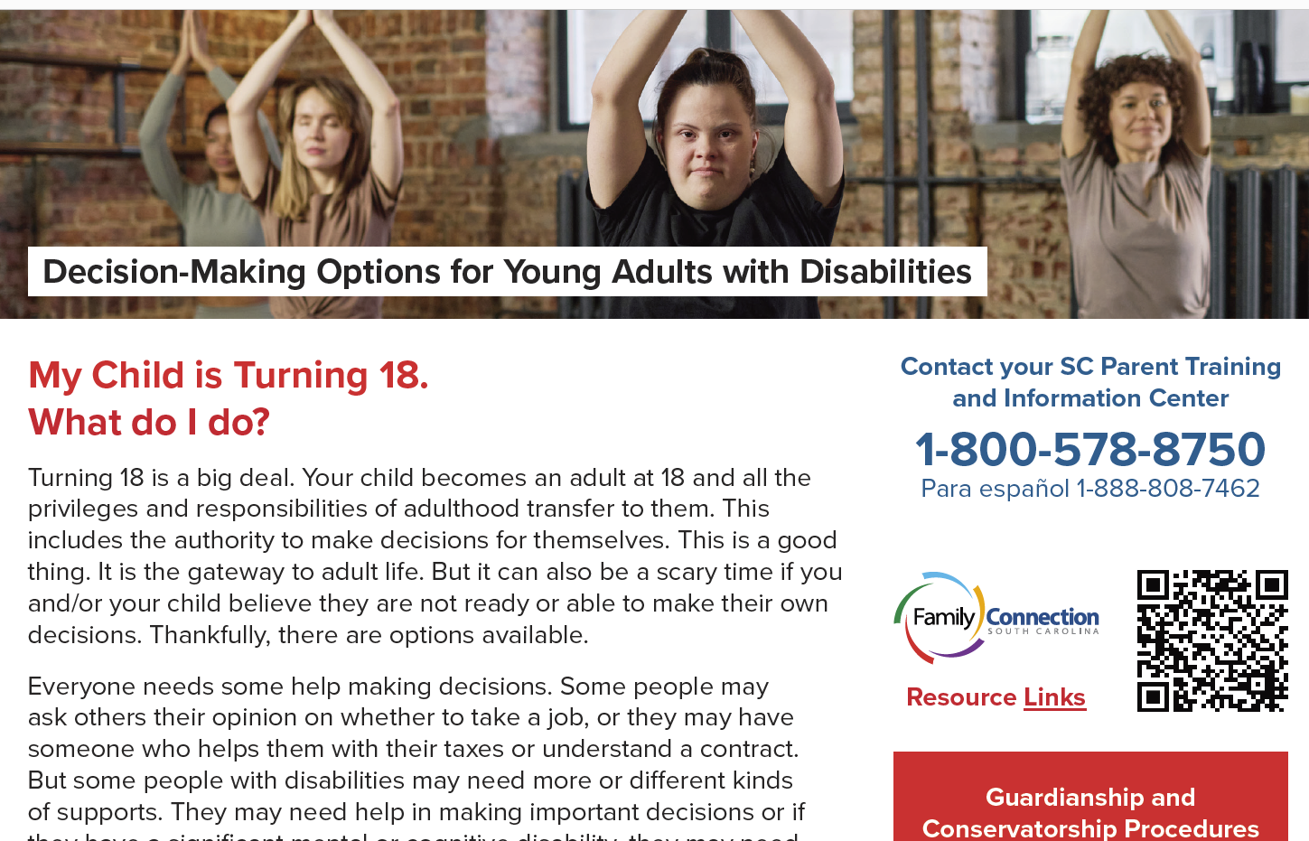
Decision Making Options

Slide 9

Young Adults Take the Reigns
B – Be a Guide – Support rather than direct.
O – Offer Choices – Give meaningful opportunities to decide.
O – Observe – Let your child try before stepping in.
T – Trust – Allow room for mistakes and learning.
S – Step Back – Gradually transfer responsibility.

Slide 10


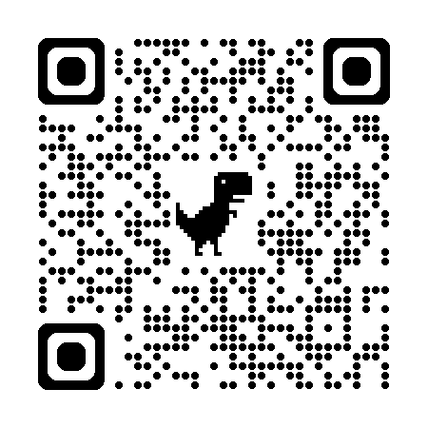
Post-Secondary Schooling Options & Additional Programs
4-year university or college
Local technical school
Workforce
How can we help students to continue to:
Be productive citizens of the world
Use their voices to continue to be heard
Use those hard-earned skills that you all taught them in the world
Day program
Volunteering
Notes:
TASC Post-Secondary Education Options – QR code
Many families do not realize that the IEP/504 does not just roll over – the student must initiate and apply for those services

Slide 11
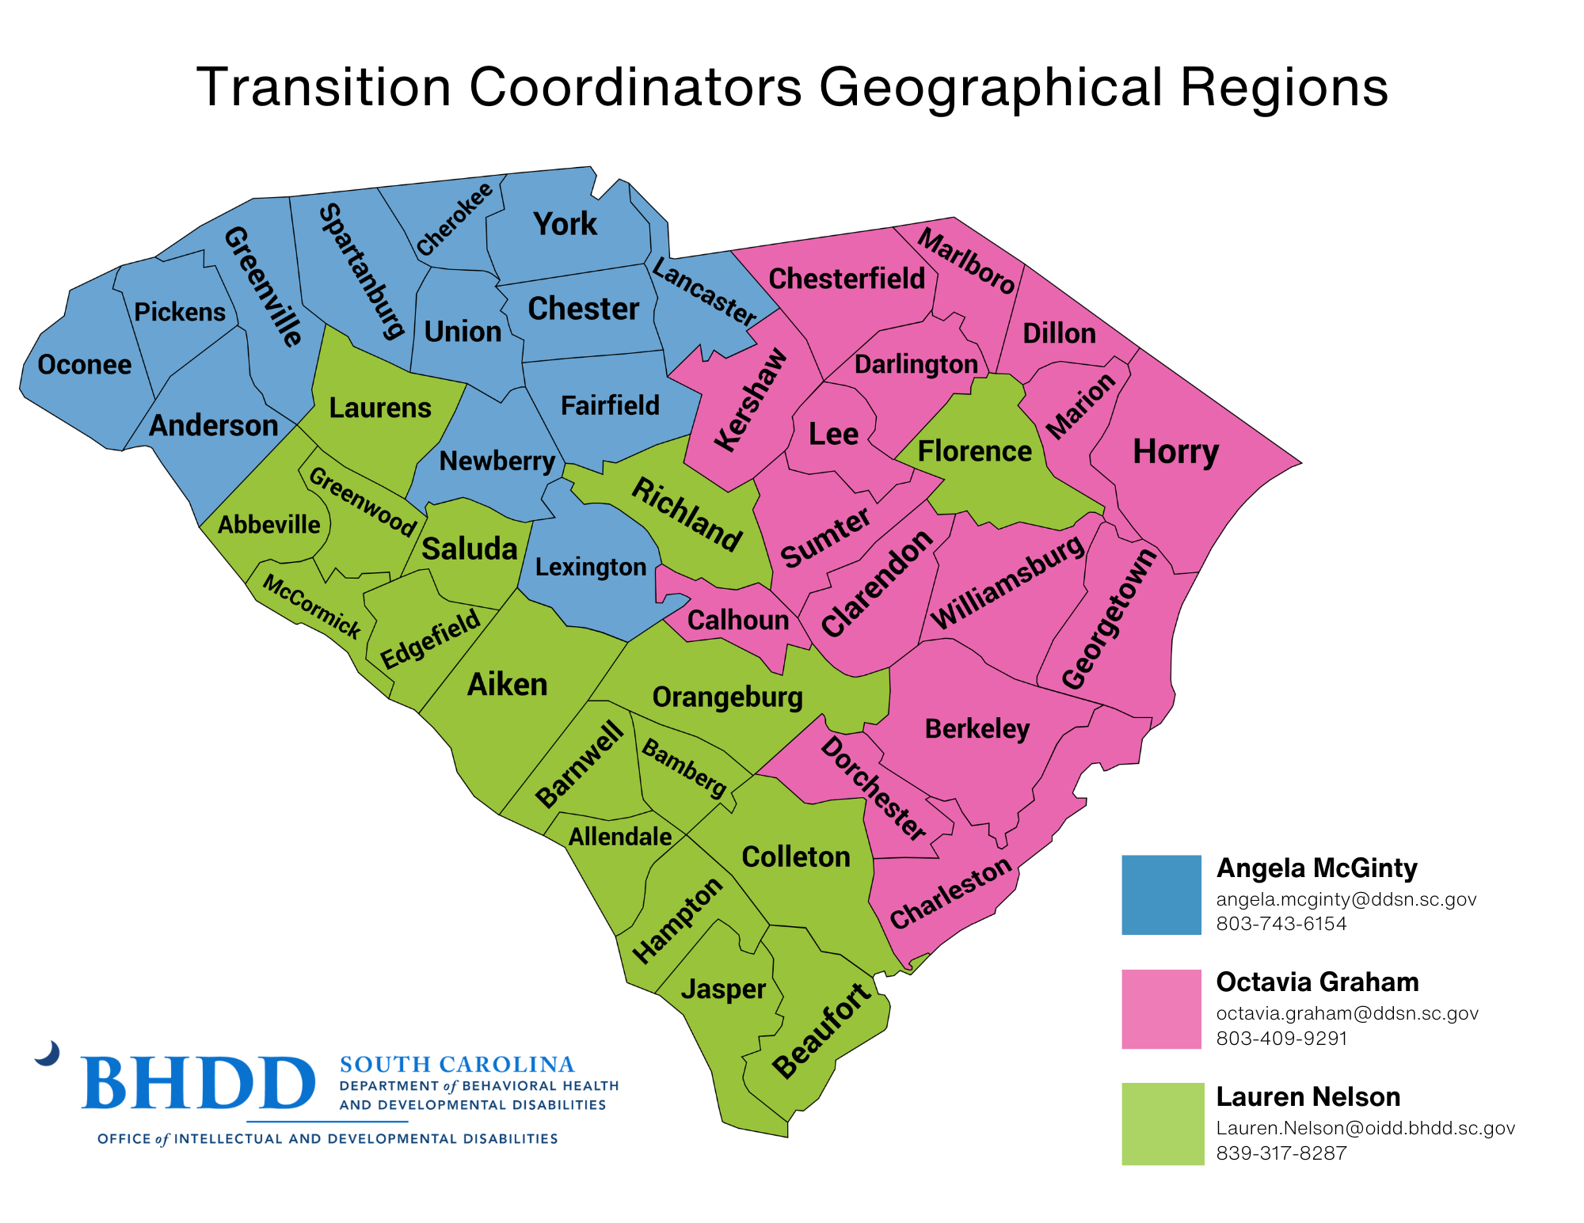


Important Resources

Slide 12

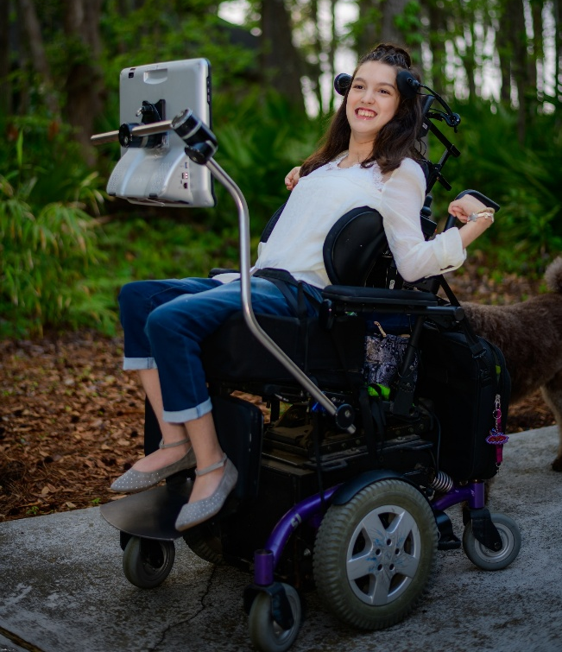
One-on-One Support from FCSC
Having a child with a disability or special healthcare need means parents face questions about medical care, insurance and service options.
Our Healthcare team can help you with Medicaid, TEFRA, appeals and managed care information. We can provide applications and provide support in person or over the phone.
Call our Support and Information Line:
Monday – Friday
8:30am – 5:00pm
1-800-578-8750
Español: 1-888-808-7462

Slide 13
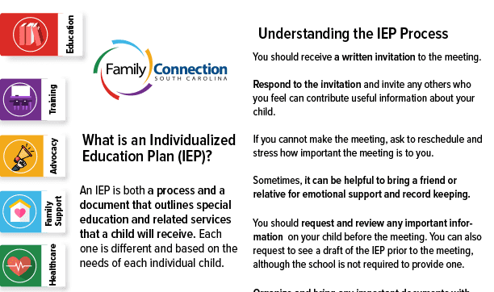
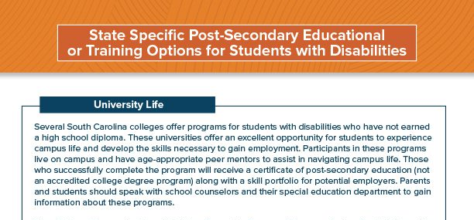
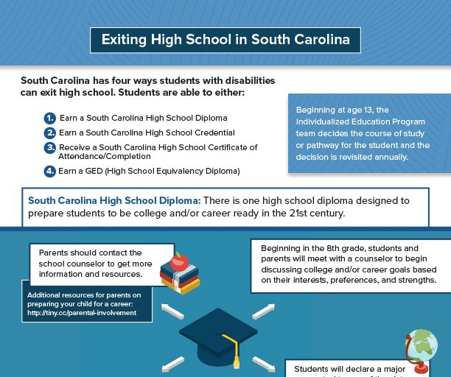
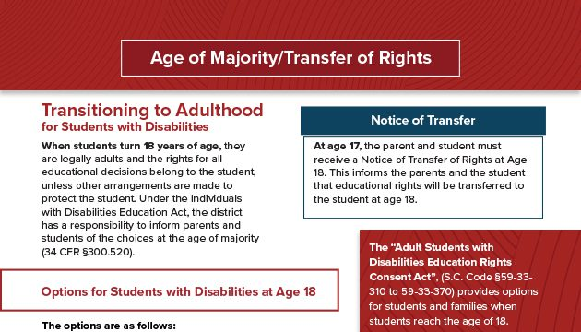
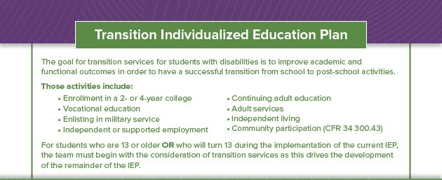
Materials for Families
Variety of Tip Sheets
At NO Cost!
Easy to order: www.FamilyConnectionSC.org/order/

Slide 14

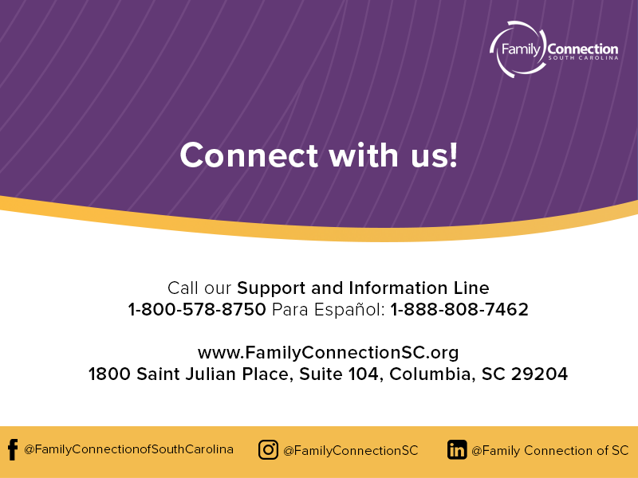

Notes:
Here is how you can connect with us!

